Slide 1
AWS Solutions Architect - Associate
Suman Dhakal AWS Solutions Architect - Associate

Slide 2
In this course
AWS basics
Identity and Access Management and S3
EC2
Databases on AWS
Advanced IAM
Route 53
VPCs
HA Architecture
Applications
Security
Serverless

Slide 3
The Exam Blueprint
130 minutes in length
65 questions (In general)
Multiple Choice
Scenarios based Questions
Qualification valid for 3 years.
Results between 100 and 1000 with a passing score of 720.
Aim for 70%.

Slide 4
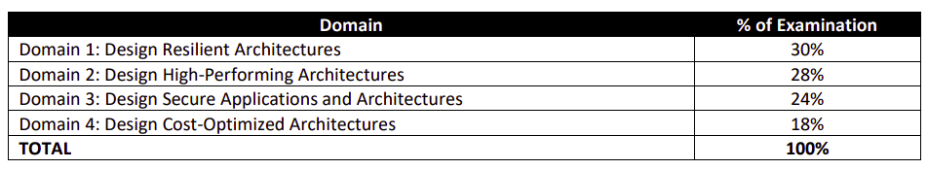
Content Outline

Slide 5
Exam Blueprint
Domain-1 - Design resilient Architectures
This domain makes up 30% of the exam and includes the following 4 objectives:
1.1 Design a multi-tier architecture solution
1.2 Design highly available and/or fault-tolerant architectures
1.3 Design decoupling mechanisms using AWS services
1.4 Choose appropriate resilient storage

Slide 6
Domain-1 - Design resilient Architectures
What you need to know?
Able to design multi-tier application architectures and know-how to decouple application components using technologies such as Amazon SQS and Amazon SWF.
Able to design highly available application in the case of component failure, and able to recover in the case of major outages. Implement AWS's high availability and fault tolerance concepts.
Understand the various block, file and object storage technologies such as Amazon EBS, Instance Store, Amazon EFS and Amazon S3, and know their use cases.
Technologies includes Amazon Elastic Load Balancing, Amazon Route 53, Amazon RDS Read Replicas and Multi-AZ, AWS Global Accelerator and Amazon CloudFront.

Slide 7
Exam Blueprint
Domain-2 - Design High-Performing Architectures
This domain makes up 28% of the exam and includes the following 4 objectives:
2.1 Identify elastic and scalable compute solutions for a workload
2.2 Select high-performing and scalable storage solutions for a workload
2.3 Select high-performing networking solutions for a workload
2.4 Choose high-performing database solutions for a workload

Slide 8
Domain-2 - Design High-Performing Architectures
What you need to know?
Able to select the best storage and database services to use for a given scenario, taking into account requirements for performance.
Technologies to increase performance may include a caching layer such as Amazon ElastiCache, Amazon DynamoDB DAX, or Amazon CloudFront and you need to select the best service to use in the situation presented.
Effectively implement elasticity and scalability to your application architectures. This means understanding at an architectural and implementation level what to use and how to build it.
Elasticity and scalability services you need to understand include AWS Auto Scaling, EC2 Auto Scaling, and how to implement these features at the application, storage, and database layers of your application using AWS technology.

Slide 9
Exam Blueprint
Domain-3 - Design Secure Applications and Architectures
This domain makes up 24% of the exam and includes the following 3 objectives:
3.1 Design secure access to AWS resources
3.2 Design secure application tiers
3.3 Select appropriate data security options

Slide 10
Domain-3 - Design Secure Applications and Architectures
What you need to know?
Configure security controls for authentication, authorization, and access and applying encryption to data.
Design isolation and separation through AWS service architecture, Amazon EC2 instance deployment options and Amazon VPC configuration.
Understand and be able to use different layer of security on AWS ecosystem.
Understand the available AWS Directory Services at a high-level and when to use them.
Implement monitoring and logging using Amazon CloudWatch and AWS CloudTrail,
Technologies you need to know for domain 3 include AWS WAF and AWS Shield, Amazon VPC, AWS KMS, AWS CloudHSM, AWS IAM, Amazon Cognito, and AWS Directory Services.

Slide 11
Exam Blueprint
Domain-4 - Design Cost-Optimized Architectures
This domain makes up 18% of the exam and includes the following 3 objectives:
4.1 Identify cost-effective storage solutions.
4.2 Identify cost-effective compute and database services.
4.3 Design cost-optimized network architectures.

Slide 12
Domain-4 - Design Cost-Optimized Architectures
What you need to know?
Understand the various cost models of compute and storage services, what you pay for and what the best choices would be given a specific scenario.
Know which services are free and be able to compare the cost of different services that may suit a specific scenario. You’ll definitely need to understand serverless technologies such as AWS Lambda, Amazon Aurora Serverless, and Amazon ECS Fargate.

Slide 13
Practice labs
https://run.qwiklabs.com/

Slide 14
Chapter 1
AWS Basics
AWS basics
Availability Zones
Regions
Edge Zones
High Availability on AWS
Scalability and Elasticity
Redundancy
High Performance Computing on AWS
AWS High level services
Compute
Databases
Storage
Network and Content Delivery
Security
Integration tools
Analytics and Monitoring

Slide 15
AWS Global Infrastructure
AWS Regions
A physical location around the world where data centers are clustered.
AWS Availability Zones
One or more discrete Data Centers with redundant power, networking, and connectivity in an AWS Region.
AZs make partitioning applications for high availability possible.
All AZ’s in an AWS Region are interconnected with high-bandwidth, low-latency networking, over fully redundant, dedicated metro fiber providing high-throughput, low-latency networking between AZ’s.

Slide 16
AWS Basics continued ...
AWS Edge Zones
Endpoints for AWS which are used for caching content. Typically, this consists of CloudFront.

Slide 17
AWS Basics continued ...
High Availability on AWS
Scalability and Elasticity
Redundancy and decoupling
High Computing on AWS

Slide 18
High Availability on AWS
High Availability
High availability refers to a system or component that is operational without interruption for long periods of time.
How to achieve High Availability ?
Remove single points of failure
Redundancy
Multiple geographic zones
Microservices

Slide 19
Scalability and Elasticity
Scalability
Ability of a system to provide throughput in proportion to, and limited only by, available hardware resources. A scalable system is one that can handle increasing numbers of requests without adversely affecting response time and throughput.
Provide the scale in a linear manner where adding extra resources results in at least a proportional increase in ability to serve additional load.
Vertical scaling and Horizontal scaling
The growth of computational power within one operating environment is called vertical scaling. Horizontal scaling is leveraging multiple systems to work together on a common problem in parallel.

Slide 20
Redundancy and Decoupling
Decoupling
A way to reduce interdependencies in a system is to allow the various components to interact with each other only through specific, technology-agnostic interfaces, such as RESTful APIs. In that way, technical implementation detail is hidden so that teams can modify the underlying implementation without affecting other components.
Redundancy
Having more than one components to perform exactly the same job.

Slide 21
AWS High level services
Compute
Understand High level Compute services in AWS– EC2, Lambda, ECS and Elastic Beanstalk.
Understand Auto Scaling and ALB, how they work together to provide High Available and Scalable solution.
Understand High power computing on AWS - EMR.
Serverless and Not serverless architecture.
A serverless architecture is a way to build and run applications and services without having to manage infrastructure. Applications still run on servers, but all the server management is done by AWS. User do not have to provision, scale, and maintain servers to run your applications, databases, and storage systems.

Slide 22
AWS High level services
Databases on AWS
Understand Relational and NoSQLs data storage options which include RDS, DynamoDB, Aurora and their use cases.
RDS - Relational Database on AWS.
Aurora - Serverless Relational Database on AWS.
DynamoDB - NoSQL Database on AWS.
Elasticache - Caching Database on AWS.

Slide 23
AWS High level services
Storage
Understand various storage options and what are the use cases and anti patterns for each.
On premises back up and Cloud Backup strategies - AWS Sync, Storage Gateway.
High level services include S3, EBS, Instance store, EFS, Glacier, FSx, AWS Snowball and AWS Snowball edge.

Slide 24
AWS High level services
Networking and Content Delivery
Understand how to create a network within AWS.
High level services include VPC, VPC endpoints, VPC peering, Security Groups and NACLs, Bastion Hosts, NAT Gateway and NAT Instance, VPN and Direct Connect, AWS Snowball and AWS Snowball edge, Application Load Balancers and Global Accelerators.
Understand CloudFront as CDN and the static and dynamic caching it provides, what can be its origin
Understand Route 53 for routing.

Slide 25
AWS High level services
Security
Understand how to securely build and secure resources on AWS.
Access management, Federation access providers on AWS.
Encryption and secrets management on AWS.
High level services include IAM, KMS, Parameter store and Secrets Manager, WAF and Shield.

Slide 26
AWS High level services
Integration tools
Understand how to decouple resources on AWS.
High level services include SQS, SQF, SNS, Kinesis and API Gateway.

Slide 27
AWS High level services
Management and Monitoring Tools
Managing and Monitoring tools within AWS.
High level services include CloudWatch, EC2 metrics, CloudTrail, CloudFormation, OpsWorks, AWS Codebuild, AWS CodeDeploy and AWS Codecommit.

Slide 28
Chapter 1
AWS IAM and S3
AWS IAM
Introduction
Features
Key terminologies: Users, Groups, Policies and Roles
AWS S3
Introduction
S3 pricing tiers
S3 versioning
Lifecycle Management with S3
S3 security and Encryption
Transfer Acceleration
AWS DataSync
CloudFront
Snowball
Storage Gateway

Slide 29
Principle of least privilege
PoLP
The principle means giving a user account or process only those privileges which are essential to perform its intended function. For example, a user account for the sole purpose of creating backups does not need to install software: hence, it has rights only to run backup and backup-related applications. Any other privileges, such as installing new software, are blocked. The principle applies also to a personal computer user who usually does work in a normal user account, and opens a privileged, password protected account (that is, a superuser) only when the situation absolutely demands it.

Slide 30
IAM Best practices
https://docs.aws.amazon.com/IAM/latest/UserGuide/best-practices.html

Slide 31
AWS IAM
Identity and Access management
IAM is a Global service.
IAM allows you to manage users and resources and their level of access to the AWS Console.
IAM offers following features.
Centralized control of AWS account.
Shared Access to your AWS account.
Granular permissions.
Identity Federation (including Active Directory, Facebook, linkedin, etc.)
Provides temporary access to user/devices and services where necessary.

Slide 32
AWS IAM
Users
Root user/ Root account
Email address you signed up with. It has all the permissions inside of AWS. That's why use of root account is discouraged. Hence comes IAM users.
Create a group and assign the permissions to the group.
IAM users
End users accessing AWS resources.

Slide 33
AWS IAM
Groups
A collection of users. Each user in a group will inherit the permissions of the group.

Slide 34
AWS IAM
Policies
Made up of policy documents, in JSON format, that allows or denies what an user can do.
Roles
Assigned to resources.

Slide 35
AWS IAM Review
Policies
Programmatic access and console access
Access keys and secret keys - Not the same as password, you cannot login into Console with access keys.
Best practices - Rotate access keys.
Password policies
New users have no permissions.
MFA

Slide 36
AWS S3 - Simple Storage Server
S3
Secure, durable, highly scalable object storage.
Data is spread across multiple devices and facilities.
Built for 99.9% availability and 99.9999999% durability.

Slide 37
AWS S3 - Simple Storage Server
S3 basics
S3 is object based.
Files can be O Bytes to 5 TB.
There is unlimited storage.
Files are stored in Buckets.
S3 is a universal namespace, i.e. names must be globally unique. It is creating a URL for every object in the bucket.
When an upload is successful, you receive an HTTP 200 code in your browser.

Slide 38
AWS S3 - Simple Storage Server
S3 Objects
Think of objects as files. An object consists of the following:
Key - Name of the object
Value - Object Data
Version ID
Metadata - Data about data (Objects)
Subresources
Access Control Lists

Slide 39
AWS S3 - Simple Storage Server
Data Consistency Model for S3
Read after Write consistency for PUTS of new objects
If you write a new file, and read it immediately afterwards, you will be able to view that data.
Eventual consistency for overwrite PUTS and DELETES (can some time to propagate)
If you update an EXISTING file or delete and read it immediately, you may get the older version or you may not. Changes to objects can take a little time to propagate.

Slide 40
AWS S3 - S3 pricing tiers
What makes up the cost of S3?
Storage (Per GB)
Requests and Data Retrievals
Data transfer
Management and Replication
Cross Region Replication and Transfer Acceleration

Slide 41
AWS S3 - S3 pricing tiers
S3 pricing tiers
S3 Standard
S3 Standard - Infrequent access
S3 Intelligent Tiering
S3 One Zone - Infrequent access
S3 Glacier
S3 Glacier Deep Archive

Slide 42
AWS S3 - S3 Standard
Key Features
General Purpose
Low latency and high throughput performance.
Designed for durability of 99.999999999% of objects across multiple Availability Zones (At least 3) and 99.99% availability.
Supports SSL for data in transit and encryption of data at rest
S3 Lifecycle management for automatic migration of objects to other S3 Storage Classes.

Slide 43
AWS S3 - S3 Standard-Infrequent Access
Key Features
For data that is accessed less frequently, but requires rapid access when needed.
Same low latency and high throughput performance of S3 Standard, with a low per GB storage price and per GB retrieval fee.
Designed for durability of 99.999999999% of objects across multiple Availability Zones (At least 3) and 99.9% availability over a given year.
Supports SSL for data in transit and encryption of data at rest
S3 Lifecycle management for automatic migration of objects to other S3 Storage Classes

Slide 44
AWS S3 - S3 Intelligent Tiering
Key Features
Best suited for Unknown or changing access
Designed to optimize costs by automatically moving data to the most cost-effective access tier, without operational overhead.
Stores objects in four access tiers, optimized for frequent, infrequent, archive, and deep archive access
S3 Intelligent-Tiering works by monitoring access patterns and then moving the objects that have not been accessed in 30 consecutive days to the Infrequent Access tier, move objects that haven’t been accessed for 90 consecutive days to the Archive Access tier and then after 180 consecutive days of no access to the Deep Archive Access tier.

Slide 45
AWS S3 - S3 Intelligent Tiering
Key Features
If the objects are accessed later, S3 Intelligent-Tiering moves the objects back to the Frequent Access tier.
No retrieval fees when using the S3 Intelligent-Tiering storage class, and no additional tiering fees when objects are moved between access tiers within S3 Intelligent-Tiering.
A monthly monitoring and Automation fee per object.
Always choose S3 Intelligent Tiering over S3 Standard, unless there are thousands of objects

Slide 46
AWS S3 - S3 Intelligent Tiering
Key Features
Stores objects in four access tiers, optimized for frequent, infrequent, archive, and deep archive access
Frequent and Infrequent Access tiers have same low latency and high throughput performance of S3 Standard.
Archive access and deep Archive access tiers have same performance as Glacier and Glacier Deep Archive
Designed for durability of 99.999999999% of objects across multiple Availability Zones and 99.9% availability over a given year.

Slide 47
AWS S3 - S3 One Zone - IA
Key Features
For data is accessed less frequently, but requires rapid access when needed.
Unlike other S3 Storage Classes which store data in a minimum of three AZs, S3 One Zone-IA stores data in a single AZ and costs 20% less than S3 Standard-IA.
Good choice for storing secondary backup copies of on-premises data or easily re-creatable data.
Same low latency and high throughput performance of S3 Standard
Designed for durability of 99.999999999% of objects in a single Availability Zone and 99.5% availability over a given year.

Slide 48
AWS S3 - S3 One Zone - IA
Key Features
Supports SSL for data in transit and encryption of data at rest
S3 Lifecycle management for automatic migration of objects to other S3 Storage Classes
Because S3 One Zone-IA stores data in a single AWS Availability Zone, data stored in this storage class will be lost in the event of Availability Zone destruction.
S3 Storage Classes can be configured at the object level and a single bucket can contain objects stored across S3 Standard, S3 Intelligent-Tiering, S3 Standard-IA, and S3 One Zone-IA.

Slide 49
AWS S3 - S3 Glacier
Key Features
Secure, durable, and low-cost storage class for data archiving.
Retrieval Options:
Standard - Default option for retrieval requests. Retrievals typically complete within 3–5 hours.
Expedited - Quickly access data when occasional urgent requests for a subset of archives are required. For all but the largest archives (250 MB+), data accessed using Expedited retrievals are typically made available within 1–5 minutes.
Bulk - Cheapest option available, takes typically complete within 5–12 hours.

Slide 50
AWS S3 - S3 Glacier
Key Features
You can upload objects directly to S3 Glacier, or use S3 Lifecycle policies to transfer data between any of the S3 Storage Classes for active data (S3 Standard, S3 Intelligent-Tiering, S3 Standard-IA, and S3 One Zone-IA) and S3 Glacier.
Designed for durability of 99.999999999% of objects across multiple Availability Zones
Supports SSL for data in transit and encryption of data at rest
Low-cost design is ideal for long-term archive
S3 PUT API for direct uploads to S3 Glacier, and S3 Lifecycle management for automatic migration of objects

Slide 51
AWS S3 - S3 Glacier Deep Archive
Key Features
Lowest-cost storage class and supports long-term retention and digital preservation for data that may be accessed once or twice in a year.
Designed for customers — particularly those in highly-regulated industries, such as the Financial Services, Healthcare, and Public Sectors — that retain data sets for 7-10 years or longer to meet regulatory compliance requirements.
Objects stored in are replicated and stored across at least three Availability Zones, protected by 99.999999999% of durability, and can be restored within 12 hours.
S3 PUT API for direct uploads to S3 Glacier Deep Archive, and S3 Lifecycle management for automatic migration of objects.

Slide 52
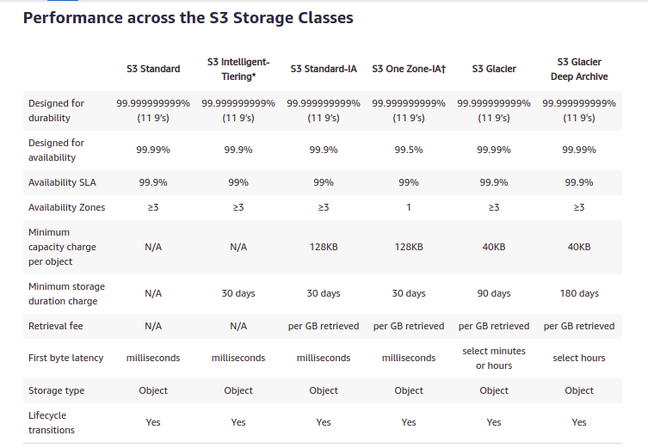

Slide 53
AWS S3 - S3 Versioning
S3 versioning
Stores all versions of an object.
Once enabled on a bucket, Versioning cannot be deleted only suspended.
Integrates with Lifecycle rules.
Versioning’s MFA Delete Capability can be used to provide an additional layer of security.

Slide 54
AWS S3 - S3 Versioning
S3 versioning
Stores all versions of an object.
Once enabled on a bucket, Versioning cannot be deleted only suspended.
Integrates with Lifecycle rules.
Versioning’s MFA Delete Capability can be used to provide an additional layer of security.

Slide 55
AWS S3 - Lifecycle management with S3
Lifecycle Management
Automates moving of objects between different storage tiers
Can be used in conjunction with versioning
Can be applied to current versions and previous versions.

Slide 56
AWS S3 - Security and Encryption
Security
By default, all the newly created buckets are Private. Access control can be setup using:
Bucket Policies - Works at Bucket level
Access Control lists - Individual Object level
S3 buckets can be configured to create access logs for all the requests made to the S3 bucket. This can be sent to another bucket or even another bucket in another account.

Slide 57
AWS S3 - Security and Encryption
Encryption
Encryption in Transit
SSL/TLS
Encryption at Rest (Server) - Server does the encryption on user’s behalf.
S3 Managed keys - SSE-S3
AWS Key Management Service Managed Keys - SSE-KMS
Server Side encryption with customer provided keys - SSE-C
Encryption at Rest (Client) - User encrypts the objects and uploads to S3.
Encryption once enabled, cannot be disabled.

Slide 58
AWS S3 - Object Lock and Glacier Vault Lock
S3 object Lock
Can be used to store objects using Write once, Read many (WORM) model. It can help you prevent objects from being deleted or modified for a fixed amount of time or indefinitely.
S3 Object lock can be used to meet regulatory requirements that require WORM storage, or add an extra layer of protection against object changes and deletion.
Can be applied to individual objects or across the bucket as a whole.
Object Lock works only in versioned buckets. Enabling Object Lock automatically enables Bucket Versioning.

Slide 59
AWS S3 - Object Lock
Governance mode
Users cannot overwrite or delete an object version or lock settings unless they have special permissions. With governance mode, you protect objects against being deleted by most users, but you can still grant some users permissions to alter retention setting or delete.
Compliance Mode
A protected object version cannot be overwritten or deleted by any user, including the root user in your AWS account.
The retention period mode cannot be changed and its retention period cannot be shortened.

Slide 60
AWS S3 - Glacier Vault Lock
Glacier Vault Lock
Allows to easily deploy and enforce compliance controls for individual S3 Glacier vaults with a Vault Lock policy.
Once locked, the policy can no longer be changed.

Slide 61
S3 performance
S3 prefixes
Multipart Upload
S3 byte range fetches
S3 select and Glacier select
Cross Region Replication
Transfer Acceleration

Slide 62
AWS S3 - Performance
S3 prefix
mybucket/folder1/document.txt > /folder1
mybucket/folder2/subfolder2/document.txt > /folder2/subfolder2
S3 performance - 3,500 PUT/COPY/POST/DELETE and 5,500 GET/HEAD requests per second per prefix.
Better performance can be achieved by spreading reads across different prefixes. For example, if two prefixes are used, 11,000 GET/HEAD requests per second can be achieved.

Slide 63
AWS S3 - Performance
Multipart Uploads
Recommended for files over 100 MB, Required for files over 5 GB.
Parallelize uploads (increases efficiency)
S3 Byte-Range Fetch
Parallelize downloads by specifying byte ranges.
Can be used to speed up downloads.
You can use concurrent connections to Amazon S3 to fetch different byte ranges from within the same object.
curl -r 0-1024 https://s3.amazonaws.com/mybucket/myobject -o part1
curl -r 1025- https://s3.amazonaws.com/mybucket/myobject -o part2
cat part1 part2 > myobject

Slide 64
AWS S3 - S3 Select and Glacier Select
S3 Select enabled applications to retrieve only a subset of data from an object by using simple SQL expressions. By using S3 select to retrieve only the data needed by the application, you can achieve drastic performance increases (Faster and Cheaper).
Glacier Select allows to run SQL queries against Glacier directly.

Slide 65
AWS S3 - S3 Select Vs Byte range fetches
In S3 Select you can request all records in the object that match a certain pattern, with a query sql-like. For instance you have a CSV file and S3 Select scans the file and returns only the rows that match the query.
Byte-range fetches treat S3 objects just like opaque bytes array: an S3 object that has 1 GB in size is just a collection of bytes. You can request for example only a part of contiguous bytes starting at some offset in the file instead of fetching all the object. It will return that piece of the object without looking at the content.

Slide 66
AWS S3 - Cross Region Replication
Versioning must be enabled on both the source and destination buckets.
Files in existing buckets are not replicated automatically.
All subsequent updated files will be replicated automatically.
Delete markers are not replicated.
Deleting individual versions or delete markers will not be replicated.
Replicate objects encrypted with AWS KMS.
Storage class for the replicated objects can be different from the source bucket storage class.

Slide 67
AWS S3 - Transfer Acceleration
S3 Transfer Acceleration utilises the CloudFront Edge Network to accelerate the uploads to S3.
Instead of uploading directly to S3 bucket, a distinct URL could be used to upload directly to an Edge Location which will then transfer the file to S3.
A distinct URL such as: cubedsteps.s3-accelerate.amazonaws.com to which files can be uploaded.
http://s3-accelerate-speedtest.s3-accelerate.amazonaws.com/en/accelerate-speed-comparsion.html
If Transfer Acceleration is used but default upload is quicker, S3 selects default upload over Transfer Acceleration

Slide 68
Data Transfer into and out of AWS
S3 DataSync
Snowball
Snowball Edge
Storage Gateway

Slide 69
AWS S3 - DataSync
Features
Allows to move large amount of data into AWS on a regular basis.
Uses Transfer protocol which performs optimization on how, when and what data is sent over the network.
Encryption at transit - Supports default encryption on S3 (SS3-S3) and EFS.
Supports storing data directly into S3, S3-IA, S3-One Zone IA, Glacier and Glacier Deep Archive.
Use filters to include/exclude objects while copying.
DataSync supports VPC endpoints (powered by PrivateLink) to move files directly into VPC.

Slide 70
AWS S3 - DataSync
How does it work?
Deploy an agent on On-premises.
Create a data transfer task.
Start the data transmission.
Use cases
Move expensive cold data to Glacier/Deep Glacier.
Copy NAS to S3.
Data Migration to S3, EFS, FSx for windows File server.
Data transfer between EFSes.

Slide 71
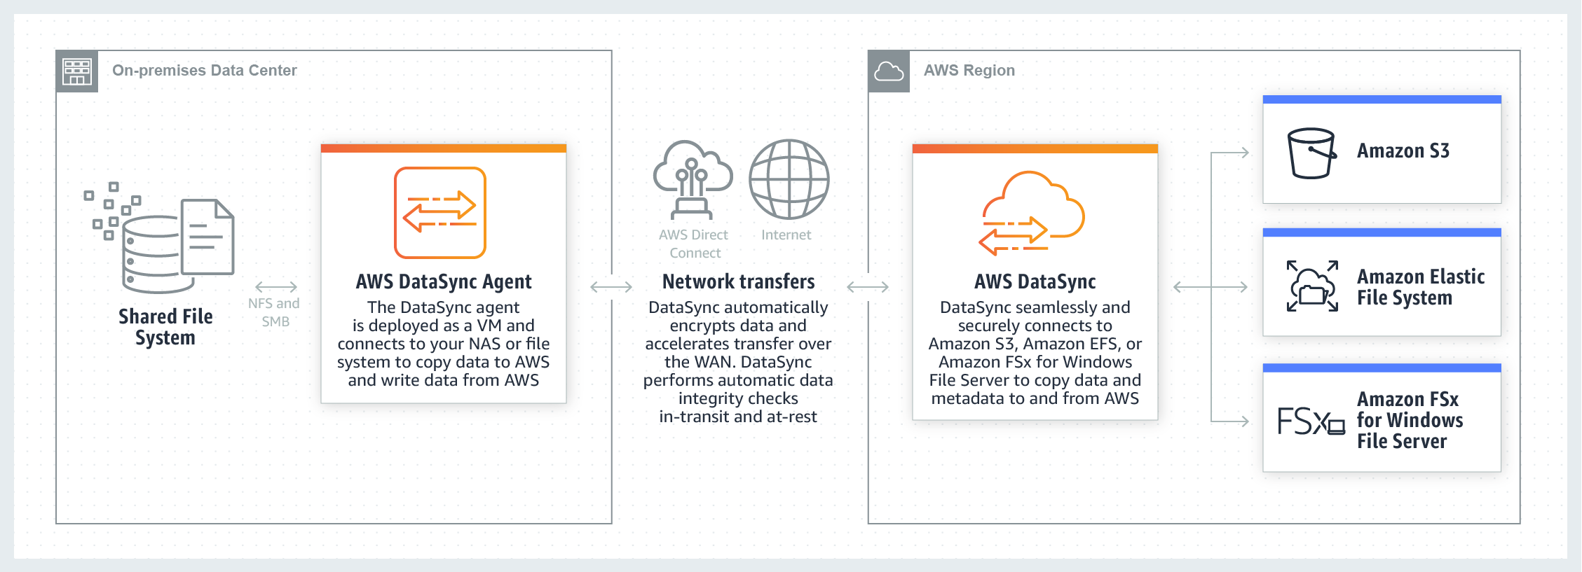
AWS S3 - DataSync - How does it work?

Slide 72
AWS S3 - Snowball
Features
Petabyte - scale data transfer solution that uses secure appliances to transfer large amounts of data in and out of AWS.
Data Transfer with Snowball can be as little as 1/5th the cost of high speed internet.
Utmost Security: Tamper-resistant enclosure, 256-Bit encryption and industry standard Trusted Platform Module (TPM).
Once transfer job has been processed and verified, AWS performs software erasure of Snowball appliances.
Snowball comes either in 50TB size or 80TB in size.

Slide 73
AWS S3 - Snowball Edge
Features
AWS snowball Edge is a 100 TB data with on-board storage and compute capabilities - like running a Lambda function.
Kind of having a mini AWS at your disposal.

Slide 74
AWS S3 - Storage Gateway
Features
AWS service that connects an on-premises software appliances with cloud-based storage.
Allows to securely store data to AWS cloud for scalable and cost-effective storage.
AWS Storage Gateway’s software appliance is available for downloads as virtual machine that you instal in your datacenter (software) or a hardware device.

Slide 75
AWS S3 - Storage Gateway
Types
File Gateway (NFS and SMB)
Files are stored as objects in S3 buckets, and accessed through NFS mount point.
Once objects are transferred to S3, they can be managed as native S3 objects, and bucket policies such as versioning, lifecycle management, and cross-region replication apply directly to objects stored in the bucket.
Files can be transferred to any of the S3 storage tiers available.

Slide 76
AWS S3 - Storage Gateway - Types
Types
Volume Gateway (iCSI)
Basically use virtual hard disk drives.
Data written to volumes can be asynchronously backed up as point-in-time snapshots and stored as EBS snapshots. The snapshots are incremental.
Stored Volumes
Lets you store primary data locally, while asynchronously backing up that data to AWS.
Provides on-premises applications with low-latency access to their entire datasets, while providing durable, off-site backups.
Data is asynchronously backed up to AWS S3 in the form of EBS snapshots.

Slide 77
AWS S3 - Storage Gateway - Types
Volume Gateway (iCSI)
Cached Volumes
Lets use AWS S3 as primary data storage while retaining frequently accessed data locally in your storage gateway.Minimizes the need to scale on-premises storage infrastructure while still providing applications with low-latency access to frequently accessed datasets.
Virtual Tape Gateway (VTL)
Lets leverage existing tape-based backup application infrastructure to store data on virtual tape cartridges that you create on your tape gateway.

Slide 78
AWS S3 - Athena
Athena
Interactive query service which allows to analyse and query data located on S3 using standard SQL.
Serverless, nothing to provision, pay per query / per TB scanned
Works directly with data stored in S3.
Commonly used to analyse log data stored in S3.

Slide 79
AWS CloudFront
Content Delivery Network (CDN)
System of distributed servers(network) that delivers web pages and other web contents to a user based on the geographic location of the user, the origin webpage and a content delivery server.

Slide 80
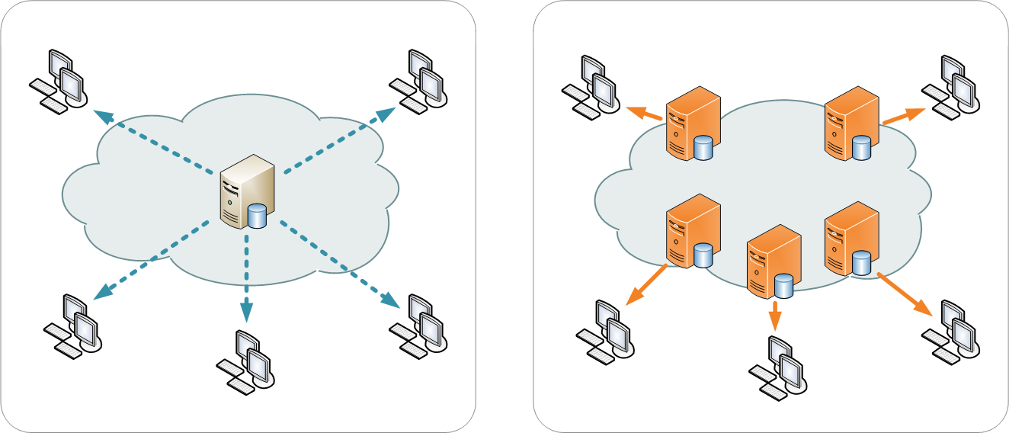
AWS CloudFront - CDN

Slide 81
AWS CloudFront
Key terminologies
Edge Locations
This the location where content is going to be cached.
Origins
Origin of all the files CDN will distribute. This can be S3 Bucket, EC2 instance or an Application Load Balancer
Distribution
The name given to the CDN which consists of collection of Edge Locations. When we create a new CDN in a network with aws means that we are creating a Distribution.

Slide 82
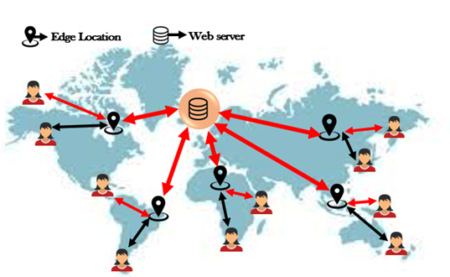
AWS CloudFront

Slide 83
AWS CloudFront
CloudFront
Can be used to deliver the entire website, including dynamic, static, streaming and interactive content using a global network of edge locations.
Requests for the content are automatically routed to the nearest edge locations, so content is delivered with best possible performance.

Slide 84
AWS CloudFront - Distributions
Types
Web Distribution
Typically used for websites.
RTMP
Used for Media streaming.
Objects are going to be cached for Time To Live (TTL).
Cached objects can be cleared (invalidation) , but will be charged.

Slide 85
AWS CloudFront - Signed URLs and Cookies
Restricting content access
Use signed URLs/Cookies when you want to secure content so that only the people you authorize are able to access it.
Signed URLs
For a single file. 1 File = 1 URL
Signed Cookies
For multiple files. 1 cookie = Multiple File.

Slide 86
AWS S3 - Signed URLs
Issues a request as the IAM user who created the presigned URL, same permissions as the user who created the URL.
Limited lifetime.
If users can directly access S3 and it’s only an individual object, use S3 signed URL, else use CloudFront signed URLs and Cookies.
If the origin is S3 and there’s a single file only,use S3 signed URL If your origin is EC2, use CloudFront.

Slide 87
AWS S3 - Hosting a Static Website using S3.
S3 allows to host a static website. The cost of hosting a website on S3 is significantly lower as compared to provisioning an EC2. There are few advantages other than having to pay less as well, naming a few here.
Low Cost and Scalability — Hosting Images on Amazon S3 gives you the ability to store a large amount of data with a very low cost. You don’t need to worry about the storage space it auto scales and available in abundance.
Data backup and availability — Hosting Images on Amazon S3 gives 99.99% availability.. The data will be protected against network and power problems as well as against hardware failure. Moreover, Amazon S3 backs up all the data in multiple zones and facilities.

Slide 88
AWS S3 - Hosting a Static Website using S3.
Security — Data stored in Amazon is secure by default because only owner and bucket have access to Amazon S3 resources. It provides encryption for both secure storage and secure transit.
Simple Data Transfer — Amazon S3 gives you many options for Cloud Data Migration. It makes is cost effective and so simple to transfer a large amount of data to Amazon S3 or out of Amazon S3.
Easy to Manage — With Amazon S3, you don’t have to worry about creating the environment for your code to run, dependencies, package upgrades, patches, networking, firewall and all the hassle that a server brings. You just upload your code and S3 will read the index.html page and hosts your website.

Slide 89
AWS S3 - Hosting a Static Website using S3.
https://howtodoitoncloud.medium.com/hosting-a-static-website-on-aws-s3-with-ssl-acfa6d6dbbd

Slide 90
Chapter 3
AWS EC2
AWS EC2 - 6 Lecture Hours
EC2 - Introduction
AWS CLI
Security Groups
EBS volumes and Snapshots
AMI Types (EBS vs. Instance Store)
ENI vs. ENA vs. EFA
CloudWatch
IAM Roles
Spot instances and Spot Fleets
EC2 Hibernate
EFS - with Lab
Amazon FSx for Windows and Amazon FSx for Lustre
EC2 Placement Groups
HPC on AWS
AWS WAF and Shield

Slide 91
AWS EC2
AWS web service that provides resizable compute capacity in the cloud.
Virtual machines in cloud.

Slide 92
AWS EC2 - Pricing Models
“You pay as you go, you pay for what you use, you pay less as you use more and you pay even less when you reserve capacity.”
Pricing Models
On-demand
Allows to pay a fixed rate per hour or by second with no commitment.
Reserved
Provides you with a capacity reservation and offer a significant discount on the hourly charge for an instance. Contract terms are 1 year or 3 years.
Modes: No upfront, Partial upfront, Full upfront. The more you pay upfront, more the saving.

Slide 93
AWS EC2 - Pricing Models
Pricing Models
Spot
Enables to bid whatever price you want for instance capacity, providing for even greater savings if your application have flexible start and end times.
Dedicated Hosts
Physical EC2 servers dedicated to a client. These are preferred when you have to use existing server-bound software licenses.

Slide 94
AWS EC2 - On Demand
Useful for
Users that want low cost and flexibility of Amazon EC2 without any up-front payment or long term commitment.
Applications with short term, spiky, or unpredictable workloads, that cannot be interrupted.
Applications being developed and tested on Amazon EC2 for the first time.
Pay per seconds or hour basis.

Slide 95
AWS EC2 - Reserved Pricing
Useful for
Applications with steady and predictable usage.
Applications that requires reserved capacity.
Users are allowed to make upfront payments to reduce total computing costs even further.
Pay per hour basis.

Slide 96
AWS EC2 - Reserved Pricing - Types
Types
Standard Reserved instances.
Upto 75% off on demand instances.
Instance types cannot be changed after the purchase.
Convertible Reserved instances
Upto 54% off on demand instances.
Instance types can be changed after the purchase.
Schedule Reserved instances
Available to launch within the time windows that you specify.
For a time-window predictable usage.

Slide 97
AWS EC2 - Spot instance pricing
Useful for
Applications that have flexible start and end times.
Urgent compute needs for large amount of additional capacity.

Slide 98
AWS EC2 - Dedicated Hosts pricing
Useful for
For licensing which does not support multi-tenancy or cloud deployments.
Can be purchased On-demand (Hourly).
Can be purchased as a Reservation for up to 70% off the On-Demand price.

Slide 99
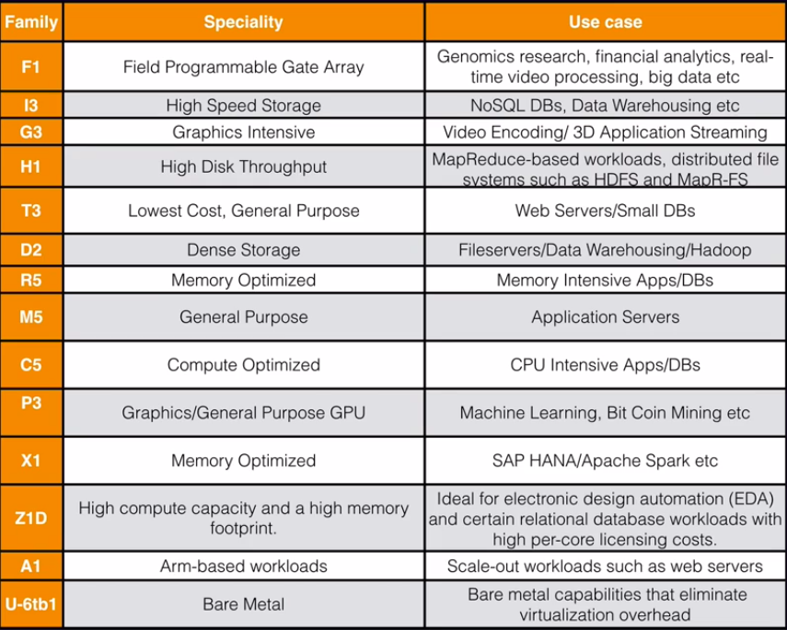

Slide 100
AWS EC2 - Terminologies
AMI
An Amazon Machine Image (AMI) provides the information required to launch an instance.
You must specify an AMI when you launch an instance. You can launch multiple instances from a single AMI when you need multiple instances with the same configuration.
Volumes
An Amazon EBS volume is a durable, block-level storage device that you can attach to your instances. After you attach a volume to an instance, you can use it as you would use a physical hard drive.

Slide 101
AWS EC2 - Terminologies
Key Pairs
Key pairs are used to login in the machine when no user is created. Ubuntu user is created by default and key pair is associated with ubuntu user.
Public IP
An IP address that can be accessed over the Internet. A public IP address is globally unique, and can only be assigned to a unique device.
Private IP
Used to assign computers within your private space without letting them directly expose to the Internet. When an instance is launched in a VPC, the instance gets a private IP, belonging to the network it is launched. The instances on the same network communicate via the private IP address assigned to them.

Slide 102
AWS EC2 - Termination Protection
Overview
To prevent accidental termination of the instances.
Turned off by default.
On an EBS-backed instance, the default action for the root EBS volume to be deleted when the instance is terminated.
Root EBS volumes can be encrypted.
Additional Volumes can be encrypted

Slide 103
AWS EC2 - Security Groups
Overview
Instance level virtual Firewalls
Stateful
Implicit deny, all inbound traffic is blocked by default.
Allow rules only, cannot explicitly deny
More than one security group can be attached and the effect is aggregate.
Changes to Security Groups are immediate.
Rules are based on Ports and sources.
Source can be a CIDR or any other security groups.

Slide 104
AWS EC2 - EBS Volumes
Types
General Purpose
Provisioned IOPS
Throughput Optimized HDD
Cold HDD
EBS Magnetic

Slide 105
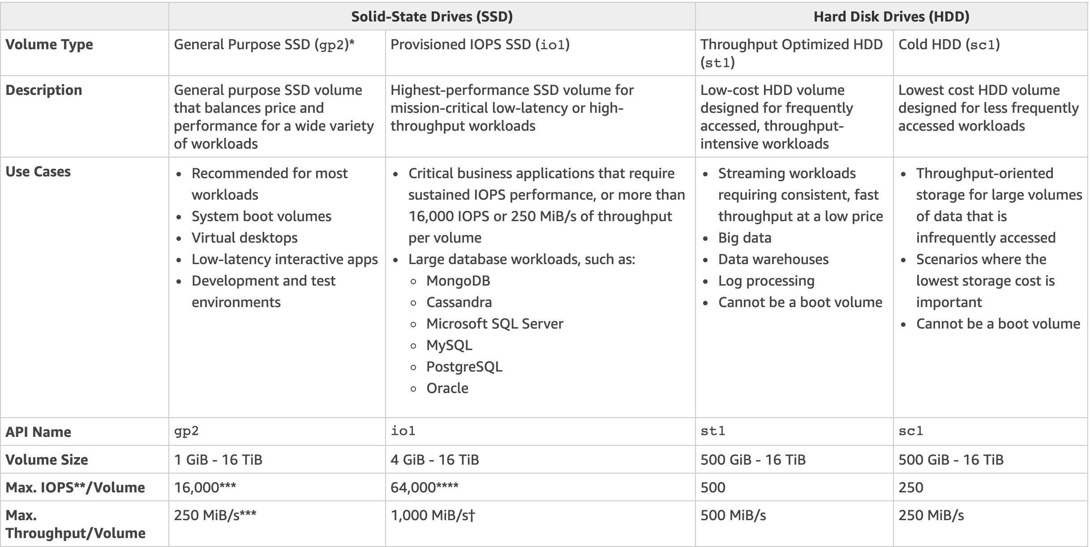

Slide 106
AWS EC2 - EBS Volumes and Snapshots - Lab
Review
EBS volumes is created on the same availability zone as EC2.
Snapshots exist on S3.
Snapshots are point in time copies of volume.
Snapshots are incremental - only the blocks that have changed since last snapshot are moved to S3.
Volume size and type can be changed after creating instance as well.

Slide 107
AWS EC2 - Encrypted Root Device volumes and Snapshot
To encrypt an unencrypted root volume;
Create a snapshot of the root volume.
Enable encryption while copying the snapshot.
Create an image from the snapshot.
Launch an instance from the AMI.

Slide 108
AWS EC2 - AMI Types
AMIs are categorized as backed by either Amazon EBS or by instance store.
EBS Volumes: The root device for an instance launched from AMI is Amazon EBS volume created from an Amazon EBS Snapshot.
Instance store volumes: The root device for an instance launched from the AMI is an instance store from a template stored in S3.
Instance store volumes are not available for all instance types.

Slide 109
AWS EC2 - AMI Types - Use case
Instance stores are ephemeral, which makes them perfect for temporary data that changes often or is consistently replicated across your environment(s).
Additionally, instance store volumes are physically attached to the host and as such, can see significant performance boosts over their EBS counterparts.
Use EBS for the backing OS partition and permanent storage (DB data, critical logs, application config). Use instance storage for in-process data, noncritical logs, and transient application state. Example: external sort storage, tempfiles, etc.

Slide 110
AWS EC2 - AMI Types - Review
Additional EBS volumes could be added after creating instance (for both EBS and Instance store backed volumes) but not instance store volumes.
Instance store volume ( Ephemeral storage) could not be stopped, only rebooted or terminated.
In case of EBS backed volumes, if a hypervisor fails, you can stop and start the instance. When stopped and started, it launches on a different hypervisor, So, if hypervisor fails, instance store volumes is lost. You can reboot both, you will not lose your data. Data is lost only if the underlying hypervisor fails.
While booting, EBS fetches only the components that are required for booting. But Instance store fetches all the components from S3 before preparing to boot. As a result, EBS backed instance launches faster than EBS backed instance.

Slide 111
AWS EC2 - AMI Types - Review
Used for temporary files and instance store is faster than EBS.
Volumes restored from encrypted snapshots are encrypted as well.
Snapshots created from encrypted volumes are also encrypted.
By default both root volumes are deleted when an instance is terminated. However, with EBS volume, you can prevent delete on termination.

Slide 112
AWS EC2 - AWS CLI
Install AWS CLI
Windows - https://awscli.amazonaws.com/AWSCLIV2.msi
Linux - sudo apt-get update && install awscli -y
You can use access keys and secret keys to make API requests via CLI or SDKs, but is discouraged if you are running your code on AWS Platform. A better practice is to IAM Roles.

Slide 113
AWS EC2 - IAM Roles
An IAM role is an IAM identity that you can create in your account that has specific permissions. An IAM role is similar to an IAM user, in that it is an AWS identity with permission policies that determine what the identity can and cannot do in AWS. However, instead of being uniquely associated with one person, a role is intended to be assumable by anyone who needs it. Also, a role does not have standard long-term credentials such as a password or access keys associated with it. Instead, when you assume a role, it provides you with temporary security credentials for your role session.

Slide 114
AWS EC2 - Bootstrap scripts
Scripts that runs immediately after an instance launches.
Can be used to automate a process.
#!/bin/bash
apt update -y
apt install apache2 -y
service apache2 start
service apache2 enable
cd /var/www/html
echo "<html><h1>Hello People Welcome To My Webpage</h1></html>" > index.html
aws s3 mb s3://cubedsteps123
aws s3 cp index.html s3://cubedsteps123

Slide 115
AWS EC2 - Instance Metadata
Instance metadata at:
http://169.254.169.254/latest/meta-data/
User data at:
http://169.254.169.254/latest/user-data/

Slide 116
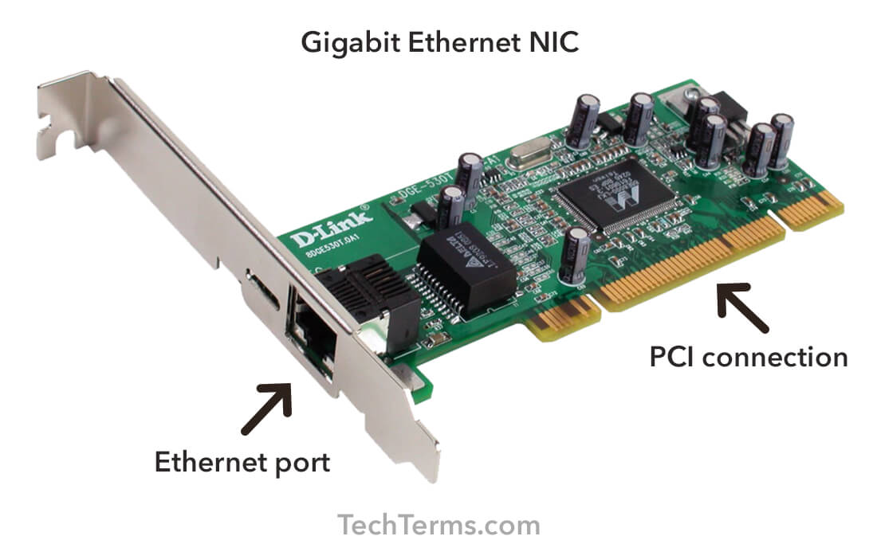
AWS EC2 - ENI vs ENA vs EFA
Elastic Network Interface
It's just basically a virtual network card on EC2 instance.
When an EC2 instance is provisioned, it's going to have a ENI attached to it automatically,
And additional ones can be attached as well

Slide 117
AWS EC2 - ENI
Elastic Network Interface allows:
A primary private IPv4 address, from the IPv4 address range of your VPC.
One or more secondary private IPv4 addresses from the IPv4 address range of your VPC.
One elastic IP address, per private IPv4 address,
One public IPv4 address
One or more IPv6 addresses.

Slide 118
AWS EC2 - ENI continued ...
One or more security groups
A MAC address source
Source/Destination check flag

Slide 119
AWS EC2 - EN
Enhanced Networking
Uses single root IO virtualization, or SR-IOV, to provide high performance networking capabilities
The SR-IOV allows different virtual machines (VMs) in a virtual environment to share a single physical bus. SR-IOV is a method of device virtualization, that provides higher IO performance and lower CPU utilization, when compared to traditional network interfaces.
EN provides higher bandwidth, higher packets per second performance consistently lower it into instance latencies, and there's no additional charge for using Enhanced Networking, but the EC2 instance does have to support it.

Slide 120
AWS EC2 - EN
Enhanced Networking
Uses single root IO virtualization, or SR-IOV, to provide high performance networking capabilities
The SR-IOV allows different virtual machines (VMs) in a virtual environment to share a single physical bus. SR-IOV is a method of device virtualization, that provides higher IO performance and lower CPU utilization, when compared to traditional network interfaces.
EN provides higher bandwidth, higher packets per second performance consistently lower it into instance latencies, and there's no additional charge for using Enhanced Networking, but the EC2 instance does have to support it.

Slide 121
AWS EC2 - EN
Enhanced Networking Adapter
Supports network speeds of up to a hundred gigabits per second, for supported instance types.
Intel 82599 virtual function or VF interface
It supports network speeds of up to 10 gigabits per second for supported instance types and it's typically used on older instances.
In any given scenario question choose ENA over virtual function simply because you get much better speed and it's not a legacy product

Slide 122
AWS EC2 - EFA
Elastic Fabric Adapter
An Elastic Fabric Adapter is a network device that can be attached to the EC2 instance to accelerate High Performance Computing or HPC, and machine learning applications.
Elastic Fabric Adapters, provide lower and more consistent latency and higher throughputs than TCP transport, traditionally used in cloud based, HPC systems,
EFA can use OS-bypass. OS-bypass enables high performance compute and machine learning applications to bypass the operating system kernel and to communicate directly with the EFA device. It makes it a lot faster with a lot lower latency. However, it's not supported on Windows currently, it's only supported with Linux.

Slide 123
AWS EC2 - ENI vs ENA vs EFA
ENI is used for basic networking. Perhaps you need a separate management workload to your production network or a separate logging network and you need to do this at a low cost. In this scenario, just use multiple ENI's for each network.
Enhanced Networking is for when you need speeds between 10 gigabits per second and 100 gigabits per second anywhere where you need reliable high throughput
Elastic Fabric Adapter, is where you need to accelerate, High Performance Computing, HPC and machine learning applications or if you need to do an OS bypass.

Slide 124
AWS EC2 - Spot Instances and Spot Fleets
Spot instances
Spot instances basically allows to take advantage of unused EC2 capacity in the cloud and spot instances are available with up to a 90% discount compared to on-demand prices
Spot instances can be used for various stateless fault tolerant or flexible applications, such as big data, containerized workloads, CI/CD, high performance computing, and other tests and development workloads as well.

Slide 125
AWS EC2 - Spot Instances and Spot Fleets
Spot prices
A maximum spot price should be proposed when provisioning the spot instance.
The spot instance will be provisioned as long as the Spot price is Below the proposed spot price.
The hourly spot instance varies depending on the capacity and the region.
If the spot price goes above the proposed spot price, you have two minutes to choose either to stop or terminate the instance.

Slide 126
AWS EC2 - Spot Instances and Spot Fleets
Spot Fleets
A Spot Fleet is a collection, or fleet, of Spot Instances, and optionally On-Demand Instances. The Spot Fleet attempts to launch the number of Spot Instances and On-Demand Instances to meet the target capacity that you specified in the Spot Fleet request. The Spot Fleet attempts to maintain its target capacity fleet if your Spot Instances are interrupted.
You can also set a maximum amount per hour that you’re willing to pay for your fleet, and Spot Fleet launches instances until it reaches the maximum amount. When the maximum amount you're willing to pay is reached, the fleet stops launching instances even if it hasn’t met the target capacity.

Slide 127
AWS EC2 - Spot Instances and Spot Fleets
On-Demand in Spot Fleet
In your Spot Fleet request, you specify your desired target capacity and how much of that capacity must be On-Demand. For example, if in your Spot Fleet request you specify target capacity as 10 and On-Demand capacity as 8, Amazon EC2 launches 8 capacity units as On-Demand, and 2 capacity units (10-8=2) as Spot.

Slide 128
AWS EC2 - Allocation strategies for Spot instances
The allocation strategy for the Spot Instances in Spot Fleet determines how it fulfills your Spot Fleet request from the possible Spot Instance pools represented by its launch specifications. The following are the allocation strategies that you can specify in your Spot Fleet request.
lowestPrice
The Spot Instances come from the pool with the lowest price. This is the default strategy. If your fleet is small or runs for a short time, the probability that your Spot Instances may be interrupted is low, even with all the instances in a single Spot Instance pool. Therefore, the lowestPrice strategy is likely to meet your needs while providing the lowest cost.

Slide 129
AWS EC2 - Allocation strategies for Spot instances
Diversified
The Spot Instances are distributed across all pools. If the fleet is large or runs for a long time, you can improve the availability of your fleet by distributing the Spot Instances across multiple pools. For example, if your Spot Fleet request specifies 10 pools and a target capacity of 100 instances, the fleet launches 10 Spot Instances in each pool. If the Spot price for one pool exceeds your maximum price for this pool, only 10% of your fleet is affected. Using this strategy also makes your fleet less sensitive to increases in the Spot price in any one pool over time.

Slide 130
AWS EC2 - Allocation strategies for Spot instances
capacityOptimized
The Spot Instances come from the pool with optimal capacity for the number of instances that are launching.
With Spot Instances, pricing changes slowly over time based on long-term trends in supply and demand, but capacity fluctuates in real time. The capacityOptimized strategy automatically launches Spot Instances into the most available pools by looking at real-time capacity data and predicting which are the most available.
This works well for workloads such as big data and analytics, image and media rendering, machine learning, and high performance computing that may have a higher cost of interruption associated with restarting work and checkpointing.

Slide 131
AWS EC2 - Allocation strategies for Spot instances
capacityOptimized
By offering the possibility of fewer interruptions, the capacityOptimized strategy can lower the overall cost of your workload.
InstancePoolsToUseCount
The Spot Instances are distributed across the number of Spot pools that you specify, valid only when used in combination with lowestPrice.
To create a fleet of Spot Instances that is both cheap and diversified, use the lowestPrice allocation strategy in combination with InstancePoolsToUseCount. Spot Fleet automatically deploys the cheapest combination of instance types and Availability Zones based on the current Spot price across the number of Spot pools that you specify. This combination can be used to avoid the most expensive Spot Instances.

Slide 132
AWS EC2 - Allocation strategies for Spot instances
Maintaining Target Capacity
After Spot Instances are terminated due to a change in the Spot price or available capacity of a Spot Instance pool, a Spot Fleet of type maintain launches replacement Spot Instances. If the allocation strategy is lowestPrice, the fleet launches replacement instances in the pool where the Spot price is currently the lowest. If the allocation strategy is diversified, the fleet distributes the replacement Spot Instances across the remaining pools. If the allocation strategy is lowestPrice in combination with InstancePoolsToUseCount, the fleet selects the Spot pools with the lowest price and launches Spot Instances across the number of Spot pools that you specify.

Slide 133
AWS EC2 - Spot instances Interruptions
Reasons for interruption
Price – The Spot price is greater than your maximum price.
Capacity – If there are not enough unused EC2 instances to meet the demand for Spot Instances, Amazon EC2 interrupts Spot Instances. The order in which the instances are interrupted is determined by Amazon EC2.
Constraints – If your request includes a constraint such as a launch group or an Availability Zone group, these Spot Instances are terminated.

Slide 134
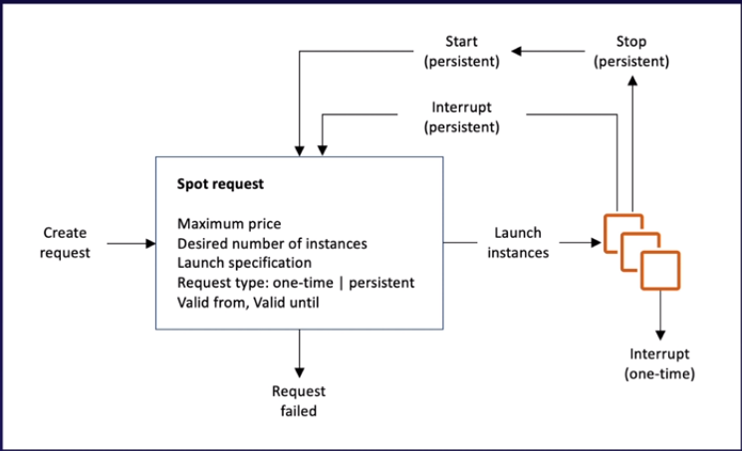
AWS EC2 - Spot instances Interruptions

Slide 135
AWS EC2 - Spot instances Interruptions Behaviour
You can specify that Amazon EC2 should do one of the following when it interrupts a Spot Instance:
Stop the Spot Instance
Requirements
For a Spot Instance request, the type must be persistent. You cannot specify a launch group in the Spot Instance request.
For an EC2 Fleet or Spot Fleet request, the type must be maintain.
The root volume must be an EBS volume, not an instance store volume.

Slide 136
AWS EC2 - Spot instances Interruptions - STOP
After a Spot Instance is stopped by the Spot service, only the Spot service can restart the Spot Instance, and the same launch specification must be used. For a Spot Instance launched by a persistent Spot Instance request, the Spot service restarts the stopped instance when capacity is available in the same Availability Zone and for the same instance type as the stopped instance.
If instances in an EC2 Fleet or Spot Fleet are stopped and the fleet is of type maintain, the Spot service launches replacement instances to maintain the target capacity.

Slide 137
AWS EC2 - Spot instances Interruptions - STOP
You can terminate a Spot Instance while it is stopped. If you cancel a Spot request, an EC2 Fleet, or a Spot Fleet, the Spot service terminates any associated Spot Instances that are stopped.
While a Spot Instance is stopped, you are charged only for the EBS volumes, which are preserved. With EC2 Fleet and Spot Fleet, if you have many stopped instances, you can exceed the limit on the number of EBS volumes for your account.

Slide 138
AWS EC2 - Spot instances Interruptions - Hibernate
Requirements
For a Spot Instance request, the type must be persistent. You cannot specify a launch group in the Spot Instance request.
For an EC2 Fleet or Spot Fleet request, the type must be maintain.
The root volume must be an EBS volume, not an instance store volume, and it must be large enough to store the instance memory (RAM) during hibernation.
Install the hibernation agent on a supported operating system

Slide 139
AWS EC2 - Spot instances Interruptions - Hibernate
When a Spot Instance is hibernated by the Spot service, the EBS volumes are preserved and instance memory (RAM) is preserved on the root volume. The private IP addresses of the instance are also preserved.
Instance storage volumes and public IP addresses, other than Elastic IP addresses, are not preserved.
While the instance is hibernating, you are charged only for the EBS volumes.
With EC2 Fleet and Spot Fleet, if you have many hibernated instances, you can exceed the limit on the number of EBS volumes for your account.

Slide 140
AWS EC2 - Spot instances Interruptions - Hibernate
Resuming a hibernated Spot Instance
After a Spot Instance is hibernated by the Spot service, it can only be resumed by the Spot service. The Spot service resumes the instance when capacity becomes available with a Spot price that is less than your specified maximum price.
If you specify hibernation as the interruption behavior, you receive an interruption notice, but you do not receive a two-minute warning because the hibernation process begins immediately

Slide 141
AWS EC2 - Spot instances Interruptions - Terminate
The instances are terminated with 2 minutes notice.

Slide 142
AWS EC2 - Spot instances Interruptions - Terminate
The instances are terminated with 2 minutes notice.

Slide 143
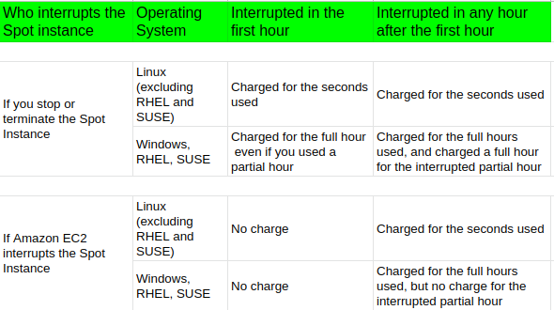
AWS EC2 - Spot instances Billing

Slide 144
NFS vs SMB
NFS is the “Network File System” for Unix and Linux operating systems. It allows files to be shared transparently between servers, desktops, laptops etc. It is a client/server application that allows a user to view, store and update files on a remote computer as though they were on their own computer.
SMB used by Windows operating systems for file sharing. SMB uses the client/server programming model. A client program makes a request of a server program (usually in another computer) for access to a file or to pass a message to a program that runs in the server computer. The server takes the requested action and returns a response.

Slide 145
AWS EC2 - EFS
EFS - Elastic File System is a network file storage service for Amazon's Elastic Compute Cloud or EC2 instances.
With the EFS, storage capacity is elastic, growing and shrinking automatically as you add and remove files so your applications have the storage they need when they need it

Slide 146
AWS EC2 - EFS
Features
Lifecycle management policy to move objects to EFS-IA.
Pay only for what you use (no pre-provisioning)
Can scale upto Petabytes.
Supports upto Thousands of concurrent connections.
Data is stored across multiple Availability zones.

Slide 147
AWS EC2 - FSx for Windows and FSx for Lustre
FSx for Windows
It basically provides a fully managed native Microsoft Windows file systems.
You can easily move your Windows based applications that require file storage to AWS and Amazon FSX is built on Windows server.
Designed for use with Microsoft applications, like SQL Server, Active Directory, IIS, SharePoint, et cetera

Slide 148
AWS EC2 - FSx for Windows and FSx for Lustre
FSx for Lustre
A fully managed file system that's optimized for compute intensive workloads, such as high performance computing, machine learning, media and data processing workflows, and electronic design automation or EDA.
Amazon FSX you can launch and run Lustre file systems that can process of massive data sets up to hundreds of gigabytes per second of throughput, millions of IOPS, and sub millisecond latencies.
Can store data directly into S3 as well.

Slide 149
AWS EC2 - Placement Groups
Just a way of placing your EC2 instances.
Types of Placement groups
Clustered placement groups
Spread placement groups
Partitioned placement group

Slide 150
AWS EC2 Placement Groups - Clustered Placement Groups
A grouping of instances within a single availability zone.
Placement groups are recommended for applications that need low network latency, high network throughput or both.
Essentially, it's a way of putting EC2 instances very, very close to each other so that you have very low network latency and very, very high network throughput.
Only certain instances can be launched into a clustered placement group.

Slide 151
AWS EC2 Placement Groups - Spread Placement Groups
Group of instances that are each placed on distinct underlying hardware such that incase any underlying hardware fails, that will affect that one EC2 instance only.
Recommended for applications that have small number of critical instances that should be kept separate from each other.
Can have spread placement groups, inside different availability zones within one region.

Slide 152
AWS EC2 Placement Groups - Partitioned Placement Groups
Similar to spread placement groups, except you can have multiple EC2 instances within a partition when using partition placement groups, Amazon EC2 divides each group into logical segments called partitions, and Amazon EC2 ensures that each partition within a placement group is on its own set of racks. allowing to isolate the impact of hardware failure within the application.
So use cases for this could be HDFS, HBase and Cassandra clusters.
A spread placement group is for single instance, partition placement groups are for multiple instances, and clustered placement groups are just a way of putting everything as close together as possible.

Slide 153
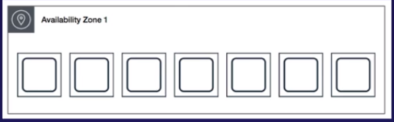
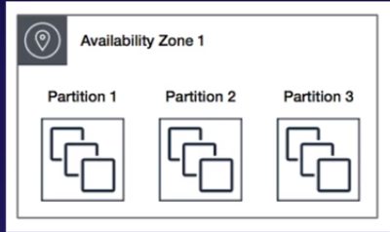
AWS EC2 Spread Vs Partitioned placement groups

Slide 154
AWS EC2 Placement Groups
A clustered placement group can't span multiple availability zones, whereas a spread placement and partitioned placement group can, but they still have to be within the same region.
The placement group must be unique within your AWS account.
Only certain types of instances can be launched in placement groups.
AWS recommend homogenous instances, within clustered placement groups.
You can't merge placement groups and you can move an existing instance into a placement group, but instance, the instance must be in the stop state.

Slide 155
AWS CloudWatch
CloudWatch is a monitoring service to monitor your AWS resources, as well as the applications that you run in AWS.
CloudWatch basically monitors performance.
CloudWatch can monitor things like
Compute - Inside Compute it can monitor things like EC2 instances, auto scaling groups,elastic load balancers, Route53 Health Checks. CloudWatch can go through and monitor metrics such as Memory Utilizations, CPU utilization, Disk, Network In/Out and Instance state.
Storage - Monitor EBS volumes, EFS filesystems, S3 - monitor how busy the storage are, Total storage used, total storage available.

Slide 156
AWS CloudWatch
CloudWatch is used for monitoring performance. CloudWatch can monitor most of AWS as well as your applications that run on AWS
CloudWatch with EC2 monitors events every five minutes by default, but with detailed monitoring turned on, gives one-minute intervals.
CloudWatch alarms can be created which trigger notifications,

Slide 157
AWS CloudTrail
Increases the visibility into your users and resource activity by recording AWS Management Console actions and API calls.
One can identify which users and accounts called AWS, the source IP address from which these calls were made, and when the calls were made.
CloudWatch is all about performance monitoring whereas CloudTrail is about auditing.

Slide 158
AWS EC2 Lab
Create an IAM role with S3 full access.
Create a Security groups with tags and related rules.
Create an EC2 instance and attach the role to EC2.
Enable encryption and termination protection.
Attach the security group to the instance.
Configure aws cli in the EC2 and test S3 permissions.

Slide 159
AWS EC2 Lab
Use this script.
Create a directory and a file name.
Cloudwatch metric status.
Create a AMI, move to another region and launch an EC2 instance there.

Slide 160
AWS Elastic Map Reduce - Apache Spark
Apache Spark is an open-source, distributed processing system used for big data workloads. It utilizes in-memory caching and optimized query execution for fast queries against data of any size. Simply put, Spark is a fast and general engine for large-scale data processing.
Apache Hadoop software library is a framework that allows for the distributed processing of large data sets across clusters of computers using simple programming models. It is designed to scale up from single servers to thousands of machines, each offering local computation and storage.

Slide 161
AWS Elastic Map Reduce
Cloud big data platform for processing vast amounts of data using open source tools, such as Apache Spark, Apache Hive, Apache Hbase, Apache Flink, Apache Hutu and Presto and with EMR, you can run petabytes scale analysis.
The central component of Elastic MapReduce is the cluster and a cluster is simply a collection of EC2 instances. Each instance in the cluster is called a node and each node has a role within the cluster and this is referred to as the node type.
EMR installs different software components on each node type, giving each node a role in a distributed application like Apache Hadoop.

Slide 162
AWS EMR - Node types
Master node
A node that manages the cluster and the master node tracks the status of tasks and monitors the health of the cluster and every cluster must have a master node.
The smallest cluster that you can have is one, and that will consist of a single master node.
Core node
A node with software components that run tasks and stores data in the Hadoop distributed file system or HDFS on your cluster.
Task node

Slide 163
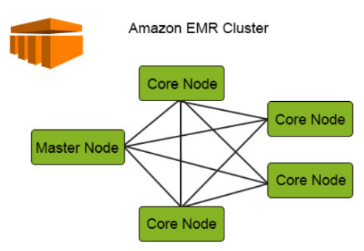
AWS EMR
Master node can communicate to all the core nodes and each core node can communicate with other core node within a cluster.

Slide 164
AWS EMR logs
All the logs are mounted on /mnt/var/log of the master node. So, if master instance is terminated, the logs are lost.
To protect log files for future use, configure your application to periodically push the logs to S3. Amazon EMR archives the logs to S3 at Five-minutes.

Slide 165
Chapter 4
Databases on AWS
Databases on AWS
Databases 101
Multi-AZ and Read Replicas
Create RDS Instance - Demo
RDS: Backups and Restore
DynamoDB
Advanced DynamoDB
Redshift
Aurora
Elasticache
Database Migration Service (DMS)
Caching Strategies on AWS
Databases Summary

Slide 166
Relational Database
Architecture
Database
Tables
Rows and Columns

Slide 167
Relational Database on AWS
SQL server
Oracle
MySQL server
PostgreSQL
Aurora
MariaDB

Slide 168
RDS has two key features
Multi AZ - For disaster Recovery
Multi AZ allows automatic failover. In case of failure on primary, AWS automatically detects and update DNS to point to secondary’s internal IP.
A write operation to the database is complete only after being written on both instance.
In the event of a planned database maintenance or DB instance failure, or an availability zone failure, Amazon RDS will automatically fail over to the standby so that the database operations can resume quickly without any administrative intervention.

Slide 169
RDS Multi AZ
Multi AZ is available for
SQL Server
Oracle
MySQL Server
PostgreSQL
MariaDB
Aurora maintains two copies of data in each AZ. So, multi AZ need not be configured for Aurora.

Slide 170
RDS has two key features
Read Replicas - For Performance
Write to one and read from many.
When primary instance fails, there is no automatic failover. The DNS has to be changed manually.
All the changes are asynchronously written to Read Replica instance.
Read replicas can be used for read-heavy database workloads.
Can promote read replicas to primary database in which case replication link is broken for it. However, replication continues for other replicas using original DB as replication source.
Read Replicas should be explicitly deleted.

Slide 171
RDS Read Replicas
If original RDS instance is deleted, without deleting read replicas, each replica is promoted to a stand-alone, single-AZ RDS instance.
Read Replicas are supported for all database types.
Automatic backups should be turned on in order to deploy a Read Replica.
Upto 5 read replicas are supported. Read Replicas of Read Replicas are also supported.
Each Read Replica has its own DNS endpoint.
Read Replicas for Multi-AZ source database are supported.
Read Replica can be created on a second region as well.

Slide 172
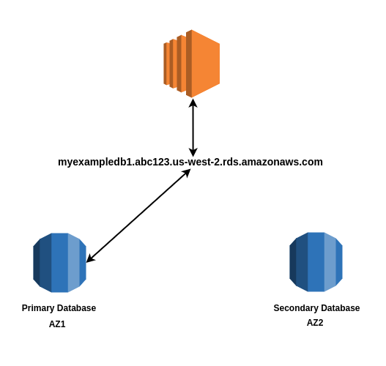
AWS RDS - Multi AZ

Slide 173
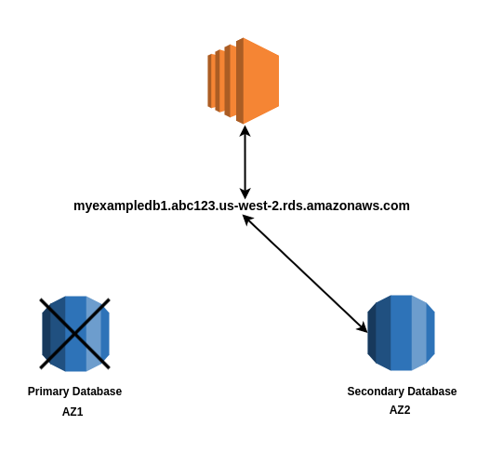
AWS RDS - Multi AZ

Slide 174
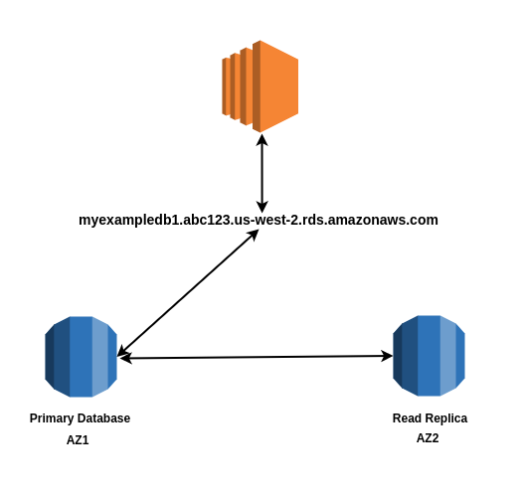
AWS RDS - Read Replicas

Slide 175
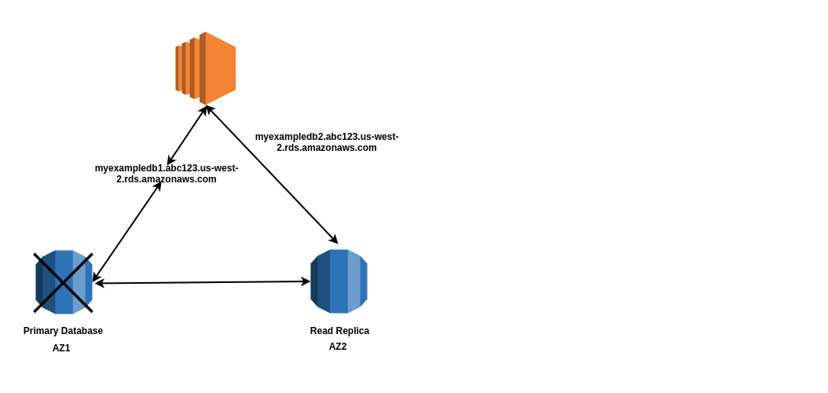
AWS RDS - Read Replicas

Slide 176
Non Relational Database
Collection ~ Table
Document ~ Row
Key Value Pairs ~ Fields/Columns
{
"student": {
"id": "abc123",
"first_name": "Suman",
"last_name": "Smith",
"Age": "25",
"address": [
{
"City": "Kathmandu",
"State": "Bagmati"
}
]
}
}

Slide 177
OLTP vs OLAP
Online Transaction Processing (OLTP) differs from Online Analytics Processing (OLAP) in terms of the query that is being run.
OLTP Example:
Order number: 212121:
Pulls a row of data such as Name, Date, Address to Deliver, etc
OLAP Example:
Net profit for Asia and Europe for a mobile phone
Pulls in large number of records:
Sums of phone sold in Asia, Sums of phone sold in Europe, Unit cost of each phone, Sales price of each phone
Sales price - unit cost

Slide 178
Data Warehousing
Used for Business intelligence
Used to pull in very large and complex data sets and usually used by management to do queries on data such as current performance versus targets, et cetera.
Data warehousing database use different type of architecture, both database perspective and infrastructure layer.
Amazon’s data warehouse solution is called Amazon Redshift.

Slide 179
Elasticache
ElastiCache is a web service that makes it easy to deploy, operate and scale an in-memory caching service in the cloud, The service improves the performance of web applications by allowing to retrieve information from fast managed in memory caches instead of relying entirely on slow at disk-based databases.
Improves the performance of databases by caching frequent identical queries.
Elasticache supports two different open-source-in-memory caching engines:
Memcached
Redis

Slide 180
Databases on AWS
RDS
SQL
MySQL
PostgreSQL
Oracle
Aurora
MariaDB
DynamoDB (NoSQL)
Redshift OLAP
Elasticache
Memached and Redis

Slide 181
RDS - Backups
Backups
Automated Backups
Allows to recover the database to any point in time within a retention period and the retention period can be between one and 35 days.
Takes a full daily snapshot and also stores transaction logs throughout the day.
When recovery is done, AWS chooses the most recent daily backup and then apply the transaction logs relevant to that day. This allows to do a point in time recovery down to a second within the retention period.

Slide 182
RDS - Automated Backups
Automated Backups
Enabled by default and the backup data is stored in S3 and you get free storage space equal to the size of the database.
Backups are taken within a defined window. So during the backup window, storage IO may be suspended while the data is being backed up and users may experience a little bit of elevated latency.
In multi-az configuration, there is no I/O suspension, since the backups are taken from secondary instance.
When an instance is deleted, all the automated backups are deleted.

Slide 183
RDS - Database Snapshots
Database snapshots
Database snapshots are done manually, i.e. user initiated. They persist even if the database instance is deleted.
Restoring backups
While restoring an automatic backup or a manual snapshot, the restored version of the database is going to be a new RDS instance with a new DNS endpoint.

Slide 184
RDS - Encryption
Encryption at Rest
Encryption at rest is supported for MySQL, Oracle SQL server, PostgreSQL, MariaDB and Aurora. Encryption is done using the AWS KMS service. Once a RDS instance is encrypted the data stored at rest in the underlying storage is encrypted as automated backups, read replicas, and snapshots.

Slide 185
RDS - Reserved Instances
Similar to EC2, the default option is On Demand, which means you pay exactly for the amount of time your servers are running. At the time RDS only supports hourly billing, while EC2 supports per-second billing. But when you purchase RDS Reserved capacity, you commit to a 1-year or 3-year period.

Slide 186
RDS - Reserved Instances - Pricing
Database Instance Class
RDS launches and manages database servers that run on EC2 instances, so you need to pay for compute time. There are a number of RDS DB instance classes available, such as db.t2.medium, db.m5.large, db.r4.large, etc. They’re basically a subset of available EC2 instance types, but they cost more compared to their EC2 counterparts (anywhere between 40%-70% more depending on instance type, DB engine and license model).

Slide 187
RDS - Pricing
Database Engine
MySQL, MariaDB, PostgreSQL, Aurora MySQL, Aurora PostgreSQL, SQL Server and Oracle.
License Model
Some engines are open source while others require you to pay for a license. There are 3 license models supported: license included (you pay for the license through RDS), bring your own license (use a license you’ve already purchased) and general public license (no license fee: MySQL, MariaDB, PostgreSQL and Aurora)

Slide 188
RDS Pricing
Redundancy options
You can choose options such as Multi-AZ deployments or read replicas if you’re using a DB engine that supports this feature, such as Aurora, MySQL, MariaDB, SQL Server and PostgreSQL.
https://www.concurrencylabs.com/blog/guide-to-rds-reserved/

Slide 189
DynamoDB
A fast and flexible NoSQL database service for all applications that need consistent, single-digit millisecond latency at any scale.
A fully managed database service and it supports both document and key-value data models.
It’s flexible data model and reliable performance make it a great fit for storing session data, mobile, web, gaming, ad-tech, IoT, and many other applications.
DynamoDB can be accessed from EC2 instances using VPC endpoints.

Slide 190
DynamoDB - Basics
DynamoDB is serverless.
Based on SSD storage.
Spread across three geographical distinct data centers.
Eventual consistent Reads
Strongly consistent Reads

Slide 191
DynamoDB - Reads
Eventual consistent Reads
Consistency across all copies of your data is usually reached within one second. Repeating a read after a short time should return the updated data.
Strongly consistent Reads
Returns a result that reflects all writes that received a successful response prior to the read.

Slide 192
DynamoDB - Expiring objects
DynamoDB allows to delete expired items from tables automatically to help reduce storage usage and the cost of storing data that is no longer relevant.
Amazon DynamoDB Time to Live (TTL) allows to define a per-item timestamp to determine when an item is no longer needed. Shortly after the date and time of the specified timestamp, DynamoDB deletes the item from the table without consuming any write throughput. TTL is provided at no extra cost as a means to reduce stored data volumes by retaining only the items that remain current for your workload’s needs.

Slide 193
DynamoDB - DynamoDB Accelerator (DAX)
Fully managed, highly available in memory cache for DynamoDB.
Gives up to a 10 times performance improvement over using just DynamoDB standalone. It also reduces request time from milliseconds, even under load.
No need to manage any of the caching logic. DAX is completely compatible with existing DynamoDB API calls.

Slide 194
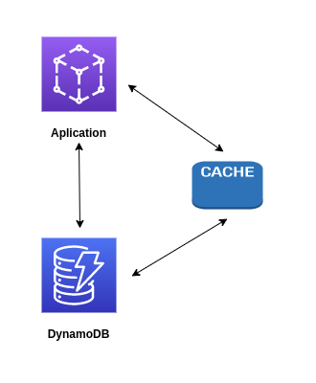
DynamoDB - DynamoDB Accelerator (DAX)
With a traditional application and cache, you’d have to code your application specifically to take advantage of that cache
Can be very expensive
Yet another thing to manage
Typically don’t support writes, only reads.

Slide 195
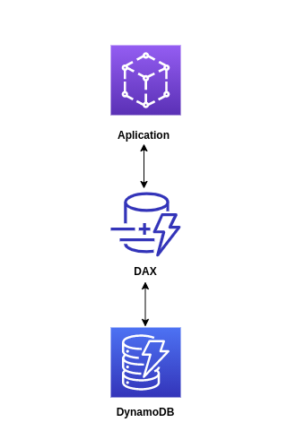
DAX sits in between the application and DynamoDB.
No code changes required.
Allows write through cache, hence, can achieve write performance improvements as well.
Writes through DAX flow directly into DynamoDB, and DAX can respond in microseconds.
It's also designed for high availability. Automatic failover to its own replica in another AZ

Slide 196
DynamoDB - On demand backup and restore
Lets to create full backups of the at any time.
Backup and restore actions execute with zero impact on table performance or availability. With RDS, there is risk of impact while creating backups.
Backups are consistent within seconds and are retained until deleted.
Backup and restore operates within the same region as the source table. Restores across regions are not supported.

Slide 197
DynamoDB - Point-in-time Recovery (PITR)
Protect DynamoDB tables from accidental writes or deletes
Can restore the data to any point in time in the last 35 days.
DynamoDB maintains incremental backups of the data.
Point-in-time recovery is not enabled by default. You have to go in and turn this on manually and the latest restorable timestamp is typically five minutes in the past.
The point-in-time recovery process always restores to a new table.

Slide 198
DynamoDB - Streams
Feature that emits events when record modifications occurs on a DynamoDB table.
Events can be insert, update and remove.
Events can carry the content of the row(s) being modified.
You can see before and after to see what changed.
Events are guaranteed to be in the same order the modifications took place.

Slide 199
DynamoDB - Streams
Features
Data are stored for 24 hours.
Guaranteed, in order events
Customizable events - Keys only (Keys of what changed), New Image (New Image only), Old Image (Old image only), New & Old images
No performance impact on source table.
Easy to integrate with Lambda.

Slide 200
DynamoDB - Streams
Use cases
Real time Dashboards
Reads all the change events on a table in real time. Everytime a insert happens, you get an event. You can then Invoke a lambda, its data being the content that was uploaded. You can then sort the data using another service, elasticsearch or such.
Data Replication for Criteria based searches.
Read from another source/DB which is of very small size compared to the main DynamoDB table.
https://www.youtube.com/watch?v=OjppS4RWWt8

Slide 201
DynamoDB - Global Tables
Managed multi-master multi-region replication solution for DynamoDB
Ideal for globally distributed applications.
Based on DynamoDB streams. You can use global tables to enable multi-region redundancy for disaster recovery or high availability applications.
No need to rewrite the applications at all; handled automatically by DynamoDB and the replication latency across regions is typically under one second for new items.

Slide 202
DynamoDB - Security
Encryption at Rest
When creating a new table, you can choose one of the following customer master keys (CMK) to encrypt the table:
AWS owned CMK – Default encryption type. The key is owned by DynamoDB (no additional charge).
AWS managed CMK – The key is stored in your account and is managed by AWS KMS (AWS KMS charges apply).
Customer managed CMK – The key is stored in your account and is created, owned, and managed by you. You have full control over the CMK (AWS KMS charges apply).

Slide 203
DynamoDB - Security
When you access an encrypted table, DynamoDB decrypts the table data transparently.
You can switch between the AWS owned CMK, AWS managed CMK, and customer managed CMK at any given time. You don't have to change any code or applications to use or manage encrypted tables.
DynamoDB continues to deliver the same single-digit millisecond latency that you have come to expect, and all DynamoDB queries work seamlessly on the encrypted data.
You can specify an encryption key when you create a new table or switch the encryption keys on an existing table by using the AWS Management Console, AWS Command Line Interface (AWS CLI), or the Amazon DynamoDB API.

Slide 204
DynamoDB - Security
Site-to-site VPN
Placing DynamoDB in a private subnet and access using Site-to-Site VPN using internet..
Direct Connect (DX)
Placing DynamoDB in a private subnet and access using Direct Connect
IAM policies and Roles
Control who/what has permissions to use DynamoDB resources and DAX.

Slide 205
Aurora
It's a MySQL and PostgreSQL your compatible relational database engine that combines the speed and availability of high-end commercial databases with the simplicity and cost-effectiveness of open source databases.
Amazon Aurora provides up to 5 times better performance than MySQL and three times better performance than PostgreSQL databases at a much lower price point while delivering similar performance and availability.

Slide 206
Aurora Cluster
Things to know about Aurora
Starts with 10 GB and scales in 10 GB increments all the way up to 64 TBs of storage. It does this automatically using storage auto-scaling.
Compute resources that can scale up to 32 vCPUs and 244 GBs of memory.
Maintains two copies of the data, which is contained in each availability zone with a minimum of three availability zones, giving you six copies of the data.

Slide 207
Aurora Cluster
Scaling Aurora
Aurora is designed to transparently handle the loss of up to two copies of data without affecting the write availability of the database and up to three copies without affecting the read availability.
Aurora storage is also self-healing. So data blocks and disks continuously scanned for errors and repaired automatically.

Slide 208
Aurora - Types
Three types of Aurora Replicas are available
Aurora is designed to transparently handle the loss of up to two copies of data without affecting the write availability of the database and up to three copies without affecting the read availability.
Aurora storage is also self-healing. So data blocks and disks continuously scanned for errors and repaired automatically.

Slide 209
Aurora - Types
Three types of Aurora Replicas are available
Aurora Replicas (currently 15)
MySQL Read Replicas (currently 5)
PostgreSQL Read Replicas (currently 1)

Slide 210
Aurora - Backups
Aurora automated backups are always enabled on Amazon Aurora database instances.Backups to not impact database performance.
You can also take snapshots with Aurora and this does not impact on performance,
You can share Aurora snapshots with another AWS accounts.

Slide 211
Aurora - Serverless
An on-demand autoscaling configuration for MySQL compatible and PostgreSQL compatible additions of Amazon Aurora
Aurora serverless database cluster automatically starts up shuts down and scales capacity up or down based on your application's needs.
Provides a relatively simple cost effective option for infrequent, intermittent, or unpredictable workloads.
Available with Postgres version for and 11.9 and MySQL version 5.6

Slide 212
Aurora - Serverless -Failover
Automatic Failover with aurora is not supported.
"If the DB instance for an Aurora Serverless DB cluster becomes unavailable or the Availability Zone (AZ) it is in fails, Aurora recreates the DB instance in a different AZ. Because Aurora separates computation capacity and storage, the storage volume for the cluster is spread across multiple AZs. Your data remains available even if outages affect the DB instance or the associated AZ."
This means, as with regular Aurora, the storage is always multi AZ. The db servers themselves are not. With regular aurora you need to set these up in a multi AZ fashion yourself, but with serverless it doesn't, instead spinning up a new db server at the point of failover.

Slide 213
Redshift
Fast and powerful, fully managed, petabyte-scale data warehouse service in the cloud.
Data-warehousing databases actually use a different architecture, both from a database perspective as well as an infrastructure layer.
Amazon's data-warehouse solution is called Redshift.

Slide 214
Redshift
Redshift can be configured as follows:
Single Node
Multi Node
Leader Node (manages clients and receive queries)
Compute Node (store data and perform queries and computations). Upto 128 compute node behind a leader node.

Slide 215
Redshift - Performance
Columnar Data Storage
Redshift compresses individual columns and because the columns contain the same data, with compression based on columns it's a lot easier to compress.
Amazon Redshift employs multiple compression techniques and can often achieve a significant compression relative to traditional relational database stores.
Massively Parallel Processing (MPP)
Automatically distributes data and query loads across all the nodes.
Redshift makes it easy to add nodes to the data warehouse and enables to maintain fast query performance as the data warehouse grows. So you can scale out with Redshift by adding more and more nodes behind the Leader Node.

Slide 216
Redshift - Performance
Redshift Spectrum
Redshift Spectrum enables to run queries against exabytes of data in Amazon S3. There is no loading or ETL required. Even if you don’t store any of your data in Amazon Redshift, you can still use Redshift Spectrum to query datasets as large as an exabyte in Amazon S3.
Materialized Views
Materialized views provide significantly faster query performance for repeated and predictable analytical workloads such as dashboards, queries from business intelligence (BI) tools, and ELT (Extract, Load, Transform) data processing.

Slide 217
Redshift - Performance
Materialized Views
Using materialized views, you can store the pre-computed results of queries and efficiently maintain them by incrementally processing the latest changes made to the source tables. Subsequent queries referencing the materialized views use the pre-computed results to run much faster. Materialized views can be created based on one or more source tables using filters, projections, inner joins, aggregations, grouping, functions, and other SQL constructs.

Slide 218
Redshift - Backups
Backups
Redshift comes with backups enabled by default with one-day retention period.
The maximum retention period is 35 days.
Redshift will always attempt to maintain at least three copies of the data (Original data and a replica on the Compute Nodes as well as a backup in S3)
Redshift can also asynchronously replicate the snapshots to S3 in another region for disaster recovery.

Slide 219
Redshift - Security
Security Considerations
Encrypted in transit using SSL.
Encrypted at rest using AES-256 encryption.
By default, Redshift takes cares of the key managements but you can manage your own keys through
Hardware Security Module (HSM)
AWS Key Management Service (KMS)

Slide 220
Redshift - Availability
Availability
Currently available on one AZ only.
Can restore snapshots to new instance in case of failure.

Slide 221
Elasticache
Introduction
A web service that makes it easy to deploy, operate and scale in-memory caching in the cloud and the service improves the performance of web applications by allowing you to retrieve information from fast managed in-memory caches instead of relying on slower disk-based databases.
Supports two open source in-memory caching engines.
Memcached
Redis

Slide 222
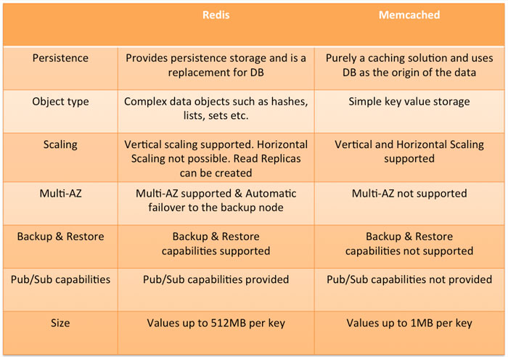

Slide 223
Database Migration service (DMS)
A cloud service that makes it easy to migrate relational databases, data warehouses, noSQL databases and other types of data stores.
Can be used to migrate the data into the AWS cloud, between on-premise instances, through using an AWS cloud setup or between combinations of cloud and on premise setups.

Slide 224
How DMS works?
DMS is a server in the AWS cloud and it runs replication software and you create a source and a target connection to tell AWS, DMS, where to extract from and load data to and then you schedule a task that runs on the server to move your data and AWS DMS creates the tables and associated primary keys. If they don't exist on the target and you can precreate the target tables manually, or you can use a thing called the AWS schema conversion tool, which is called SCT to create some or all of the target tables, indexes, views, triggers, et cetera.

Slide 225
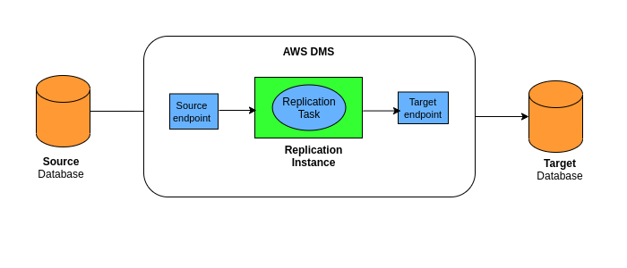

Slide 226
Types of DMS Migrations
Supports homogeneous migrations
Migration between same database types. For instance, between Oracle database on on-prem to Oracle database on AWS.
Supports heterogeneous migrations
Migration between different database types. For instance, between SQL server on on-prem to Aurora on AWS.
AWS Schema Tool (SCT) is required for heterogeneous migration.

Slide 227
Sources
On premise and EC2 instance databases: Oracle, Microsoft SQL server, mySQL, Maria DB, PostgreSQL, SAP, MongoDB, and DB2.
Azure SQL databases.
Amazon RDS, (including Aurora)
S3
Targets
On premise and EC2 instance databases:Oracle, Microsoft SQL server, MySQL, MariaDB, PostgreSQL,and SAP
RDS
Redshift
DynamoDB
S3
Elastisearch service
Kinesis data streams
DocumentDB

Slide 228
Caching strategies on AWS
Caching services on AWS
CloudFront
API Gateway
AWS Elasticache - Redis and Memcached
DynamoDB Accelerator (DAX)

Slide 229
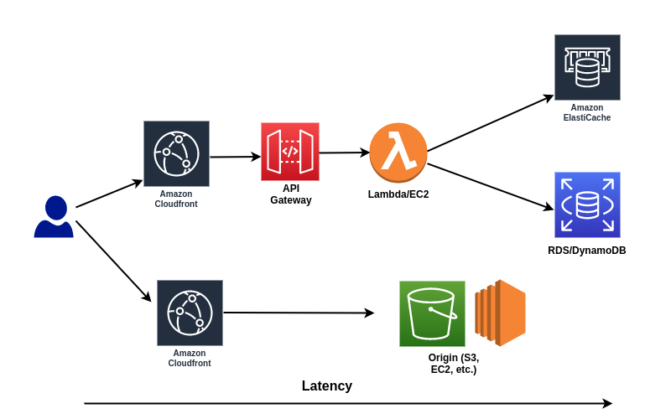
Caching strategies on AWS

Slide 230
Chapter 5
Advanced IAM
Advanced IAM
AWS Directory Service
IAM Policies
AWS Resource Access Manager (RAM)
AWS Single Sign-On
Advanced IAM Summary

Slide 231
IAM Policies
Amazon Resource Name (ARN)
The ARN uniquely identifies any resource in AWS.
All arns begin with:
arn:partition:service:region:account_id:
aws|aws-cn
s3|ec2|rds
us-west-2| eu-west-1
123456789123
And ends with: resource resource_type/resource
resource_type/resource/qualifier/
resource_type:resource
resource_type:resource:qualifier

Slide 232
IAM Policies - ARN examples
arn:aws:iam::982073526756:user/ptiwari
arn:aws:s3:::cubedsteps/image.png
arn:aws:ec2:us-west-2:12345678912:instance/* --> * is wildcard and represents all the ec2 instances in a particular account ni a region.

Slide 233
IAM Policies
JSON documents that define permissions.
Each statement matches an AWS API request.
Types of policies:
Resource policies
Attached to the resources, such as S3, KMS and SQS queues.
Defines who has permissions to the resources and what they can do with the permissions.
Identity policies
Attached to IAM users, groups and roles.
Defines what an identity can and cannot do.

Slide 234
{
"Version": "2012-10-17",
"Statement": [
{
"Sid": "ConsoleAccess",
"Effect": "Allow",
"Action": [
"s3:GetAccountPublicAccessBlock",
"s3:GetBucketAcl",
"s3:GetBucketLocation",
"s3:GetBucketPolicyStatus",
"s3:GetBucketPublicAccessBlock",
"s3:ListAllMyBuckets"
],
"Resource": "*"
},
{
"Sid": "ListObjectsInBucket",
"Effect": "Allow",
"Action": "s3:ListBucket",
"Resource": ["arn:aws:s3:::bucket-name"]
},
{
"Sid": "AllObjectActions",
"Effect": "Allow",
"Action": "s3:*Object",
"Resource": ["arn:aws:s3:::bucket-name/*"]
}
]
}
A Policy document is a list of statements.
Each statement matches an AWS API request.
SID: Human readable string for the statement heading.
Effect is either allow or deny.
Matched based on the actions; servicename: actionname
Action can use wildcards which allows all the API requests that starts with that string.
Resource Action is against.

Slide 235
IAM Policies
Not explicitly allowed == implicitly denied
Explicit deny > Everything else
Only attached policies have effect.
AWS joins/unions all applicable policies.
AWS managed Vs. Customer Managed Policies

Slide 236
Permissions Boundaries
An advanced feature for using a managed policy to set the maximum permissions that an identity based policy can grant to an IAM entity.
Used to prevent privilege escalation or unnecessarily broad permissions and entities permissions boundary allows it to perform only the actions that are allowed by both its identity based policies and its permission boundaries. In other words,it controls the maximum permissions an IAM policy can grant.
Use cases:
Developers that create roles for Lambda functions,
Application owners creating roles for EC2 instances or administrators creating ad hoc users
Admins creating ad hoc users

Slide 237
AWS Organizations
An account management service that enables to consolidate multiple AWS accounts into an organization that can be created and managed centrally.
Multiple AWS accounts are managed under a Organizational Unit (OU).
Service Control Policies (SCP) can be applied to organizational units, or to accounts and restrict access. The policies are inherited by all the child entities
Consolidated billing can be used for AWS organizations. The fundamental principle behind pricing with AWS is the more that you use, the less that you pay. When you use consolidated billing with AWS Organizations, it takes into account the aggregate of all accounts. The advantages of consolidated billing is it's one bill per AWS account, it's very easy to track charges and allocate costs, and you get volume pricing discount.

Slide 238
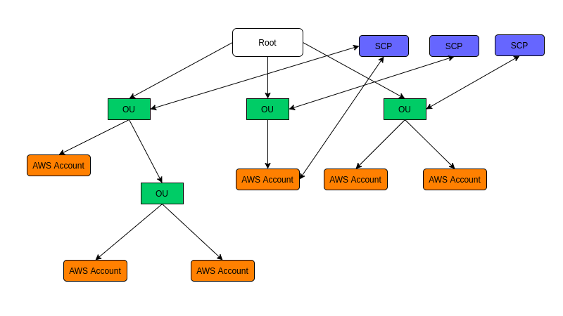
AWS Organizations

Slide 239
AWS Resource Access Manager (RAM)
Multi Account strategy
Segregating resources according to the environment.
Share resources across accounts.
Create resources centrally and use AWS RAM to share the resources with other accounts. This reduces operational overhead because you won't be duplicating resources in each account, and which can be a real pain to manage as well.
Every type of resource in AWS cannot be shared using RAM. the only sharable services are: App Mesh, Aurora, CodeBuild, EC2, EC2 Image Builder, License Manager, Resource Groups, and Route 53.
Services inside of Private VPCs require that the accounts are within same Organizational Unit.

Slide 240
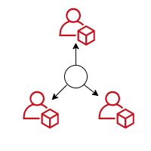


AWS Single Sign-On
Managing user and permissions for all the individual accounts in a multi account environment might be cumbersome. It can be simplified using AWS Single Sign on.
Single sign on ( SSO) is a service that helps centrally manage access to AWS accounts and business applications like G suite, Office 365, Github, Dropbox, Atlassian and so on.
Centrally managed accounts
Use existing credentials
SSO access to business applications

Slide 241
Active Directory Domain Service
Active Directory (AD) is a database and set of services that connect users with the network resources they need to get their work done.
The database (or directory) contains critical information about the environment, including what users and computers there are and who’s allowed to do what. For example, the database might list 100 user accounts with details like each person’s job title, phone number and password. It will also record their permissions.
The services control much of the activity that goes on in an IT environment. In particular, they make sure each person is who they claim to be (authentication), usually by checking the user ID and password they enter, and allow them to access only the data they’re allowed to use (authorization).

Slide 242
Microsoft AD
A server running the Active Directory Domain Service (AD DS) role is called a Domain controller. It authenticates and authorizes all users and computers in a Windows domain type network. Assigning and enforcing security policies for all computers and installing or updating software.
Active Directory provides sign-on service. With an AD FS infrastructure in place, users may use several network resources using only one set of credentials stored at a central location, as opposed to having to be granted a dedicated set of credentials for each service.

Slide 243
Microsoft AD
AD has three main tiers: domains, trees and forests. A domain is a group of related users, computers and other AD objects. Multiple domains can be combined into a tree, and multiple trees can be grouped into a forest.
Domain is a management boundary. The objects for a given domain are stored in a single database and can be managed together. A forest is a security boundary. Objects in different forests are not able to interact with each other unless the administrators of each forest create a trust between them. For instance, if you have multiple disjointed business units, you probably want to create multiple forests.

Slide 244
AWS Directory Service
Family of managed services,
Connect AWS resources with existing on premises, Microsoft AD.
Standalone directory in the cloud,
Use existing corporate credentials. User can also log into the AWS management console using those same existing corporate credentials.
SSO across any domain joined EC2 instance.

Slide 245
AWS Managed Microsoft AD
AD Domain controllers (DCs) running Windows Server.
Two Domain controllers in different AZs, so highly available by default.
Reachable by applications inside of the VPC.
Exclusive access to DCs.
Extend existing AD to on-premises using AD Trust.

Slide 246
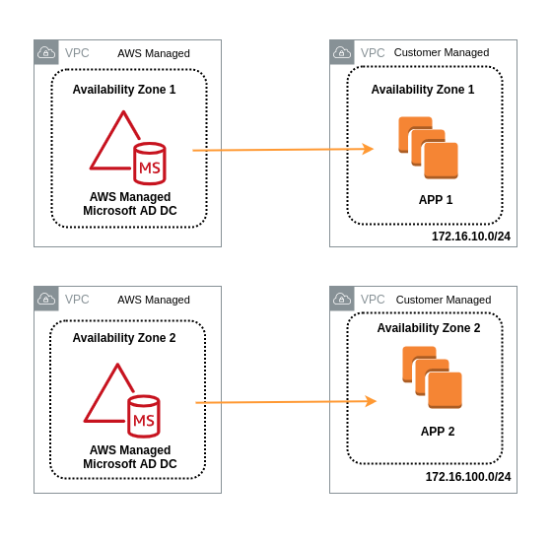

Slide 247
Responsibility sharing
AWS
Multi AZ deployment
Patch, Monitor, Recover
Instance Rotation
Snapshot and restore
Customer
Users, Groups, GPOs
Scale out DCs.
Trusts (Resource Forest)
Certificate authorities

Slide 248
Simple AD
Standalone directory in the cloud.
Supports Basic AD features
Available sizes: Small: <=500; Large <=5000 users
Easier to manage: Allows SSO on EC2 machines, using Business applications as well.
Linux workloads that need LDAP.
Doesn’t support Trusts (cannot join on-premises AD)

Slide 249
AD Connector
Directory gateway for on-premises AD.
Allows on-premises users to log into AWS using AD.
Join EC2 instances to existing AD domain in on-premises.

Slide 250
Chapter 6
AWS VPC
VPC Overview
Public and Private Subnets
Internet Gateways
NAT Instances and NAT Gateways
NACL vs. Security Groups
VPC Flow Logs
Bastions
Direct Connect
Global Accelerator
VPC Endpoints
AWS PrivateLink
AWS Transit Gateway
AWS VPN CloudHub
AWS Network Costs
Sharing applications across VPCs
Transit Gateway

Slide 251
AWS VPC Overview
Amazon's Virtual Private Cloud, Amazon VPC, lets to provision a logically isolated section of the AWS Cloud where the users can launch AWS resources in a virtual network that they define.
Users have complete control over the virtual networking environment, including selecting own IP address ranges, creation of subnets and configuration of route tables, as well as network gateways.
Users can easily customize the network configuration for a VPC. like creating a public-facing subnet for the web servers that has access to the internet, and then placing the backend systems such as databases, application servers in a private-facing subnet with no direct internet access.

Slide 252
AWS VPC Overview
In doing that, web servers are exposed to the internet but the sensitive application and database servers are not exposed to the internet.
The user can leverage multiple layers of security, including security groups as well as network access control lists to help control access to Amazon EC2 instances in each subnet.
A VPC is region bound.
1 subnet = 1 Availability Zone. Subnets cannot span AZs but one AZ can have multiple subnets.
The maximum number of VPCs allowed in a region is 5.

Slide 253
AWS Default VPC vs Custom VPC
Ease of access, allows to immediately deploy instances.
All subnets in a default VPC have a route out to the internet; they're all internet accessible.
Each EC2 instance has both a public and private IP address.
A VPC is completely isolated with another. The resources within a VPC cannot access resources inside of the other.

Slide 254
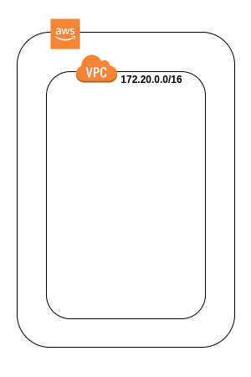
AWS VPC

Slide 255
AWS VPC and Subnet Relationship
Public subnet
A subnet that's associated with a route table that has a route to an Internet gateway.
Private subnet
Instances in private subnet doesn't have direct access to the internet.

Slide 256
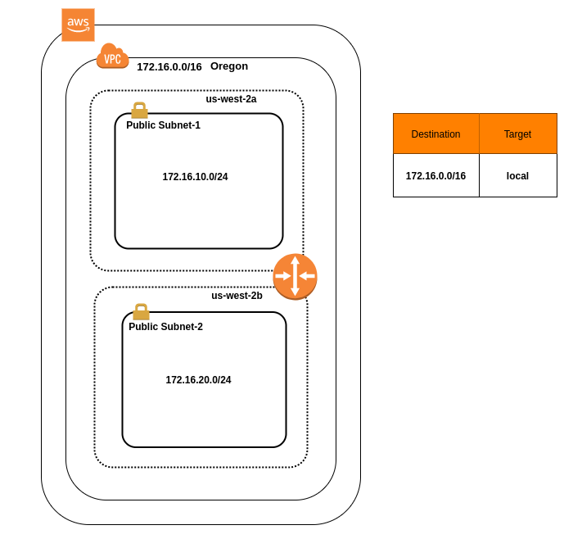
AWS VPC and Subnet Relationship

Slide 257
Internet access to a Subnet
For a subnet to access internet, following are required.
Public IP address
Internet gateway attached to a VPC
Route to internet gateway
Network Access Control list (NACL) allow rule
Security group allow rule

Slide 258
Internet access to a subnet
Public IP
An IP address that can be accessed over the Internet.
A public IP address is globally unique, and can only be assigned to a unique device.
Private IP
IP assigned to resources within a private network without letting them directly expose to the Internet.
When an instance is launched in a VPC, the instance gets a private IP, belonging to the network it is launched on. The instances on the same network communicate via the private IP address assigned to them.

Slide 259
Internet access to a subnet
Elastic IP
An elastic IP is a public IP that is allocated to an AWS account.
Internet Gateway
An internet gateway is a horizontally scaled, redundant, and highly available VPC component that allows communication between your VPC and the internet.
There's no additional charge for having an internet gateway in your account.
You can have only one internet gateway per VPC.

Slide 260
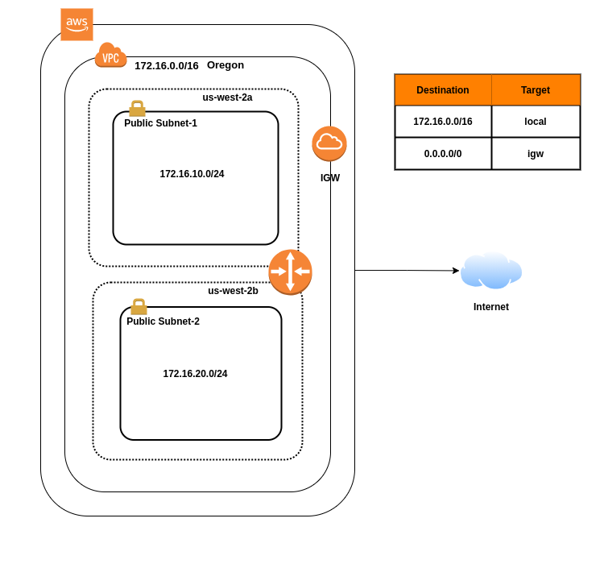
Internet access to a subnet

Slide 261
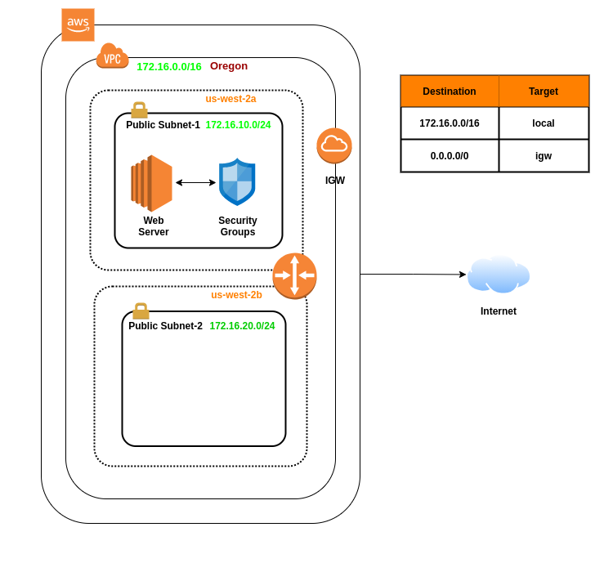
VPC and Security Group Relationship

Slide 262
NAT Instances and NAT Gateways
The resources on the private subnet access internet by using NAT instance/Gateways.
In addition to this, the gateway makes sure that the internet doesn’t initiate a connection with the instances.
NAT instances are individual EC2 instances that are configured to allow the resources on the private subnet to access the internet. You can choose pre-configured AMI from AWS AMI marketplace to serve as NAT instance. .

Slide 263
NAT Instances and NAT Gateways
For NAT instance, Source/Destination checks on instance must be disabled.
Each EC2 instance performs source/destination checks by default; the instance must be the source or destination of any traffic it sends or receives. However, a NAT instance must be able to send and receive traffic when the source or destination is not itself. Therefore, source/destination checks should be disabled on the NAT instance.
NAT instances are not highly available and not scalable. The amount of traffic that NAT instance supports depends on size of the EC2 instance
NAT Gateways are highly, highly scalable gateway that scales according to the load.

Slide 264
NAT Instances and NAT Gateways
If resources in multiple AZ share NAT, and the AZ containing NAT goes down, the other AZs lose connectivity to the internet as well. To prevent this, NAT AZs could be set on Multiple AZs and configured accordingly.
NAT Gateways are always preferred over NAT instances.
Both NAT Instances and NAT Gateways are launched on Public Subnets.

Slide 265
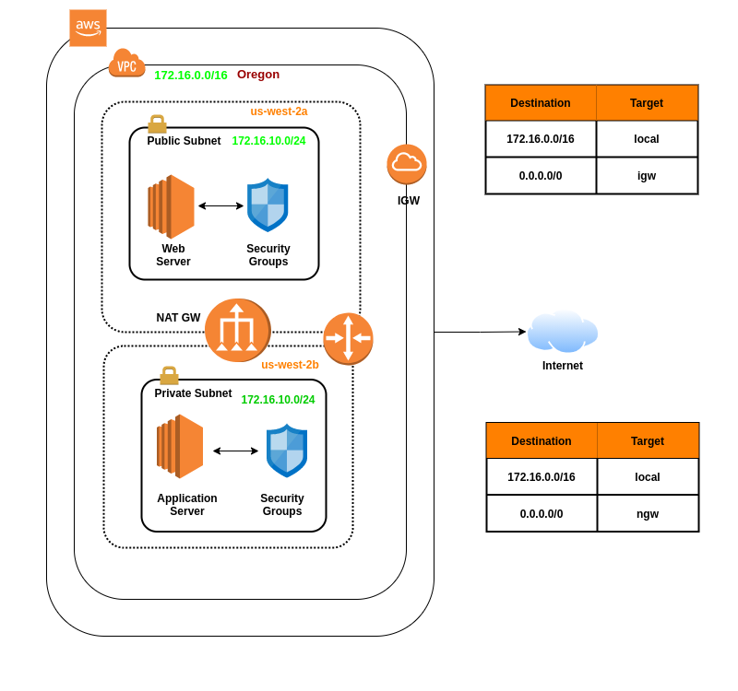
NAT Gateways and Private Subnets

Slide 266
Network Access Control Lists (NACL)
A network access control list (ACL) is an optional layer of security for your VPC that acts as a firewall for controlling traffic in and out of one or more subnets, i.e at Network Level.
Each VPC automatically comes with a modifiable default network ACL. By default, it allows all inbound and outbound traffic.
Custom network ACL can be created and associated with a subnet. By default, each custom network ACL denies all inbound and outbound traffic until rules are added.
Each subnet in your VPC must be associated with a network ACL. Unless a subnet is explicitly associated with a network ACL, the subnet is automatically associated with the default network ACL.

Slide 267
Network Access Control Lists (NACL)
A Network ACL can be associated with multiple subnets. However, a subnet can be associated with only one network ACL at a time. When you associate a network ACL with a subnet, the previous association is removed.
A network ACL contains a numbered list of rules. The rules are evaluated in order, starting with the lowest numbered rule, to determine whether traffic is allowed in or out of any subnet associated with the network ACL. The highest number allowed for a rule is 32766.
A network ACL has separate inbound and outbound rules; Network ACLs are stateless, which means that responses to allowed inbound traffic are subject to the rules for outbound traffic (and vice versa).

Slide 268
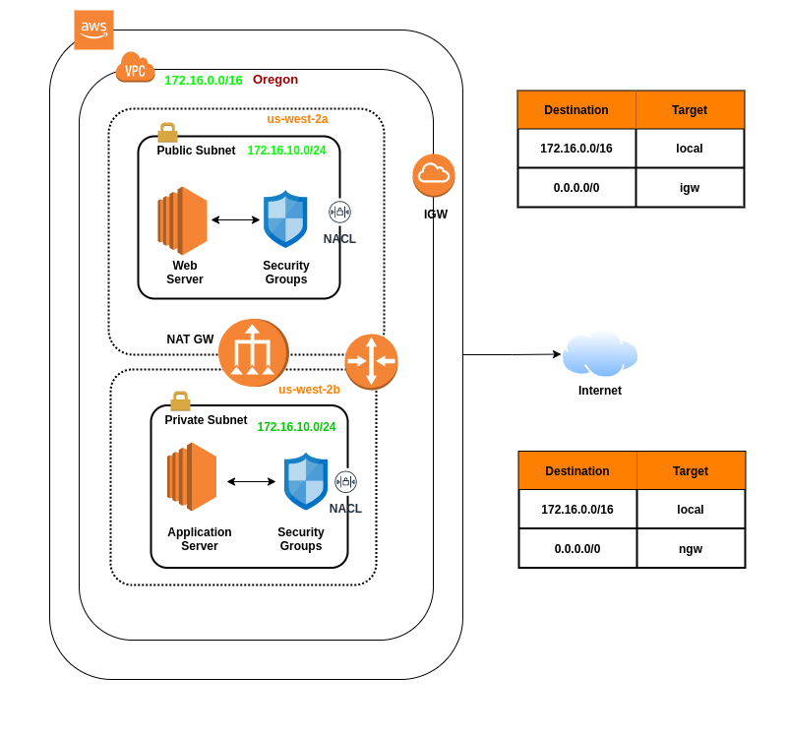

Slide 269
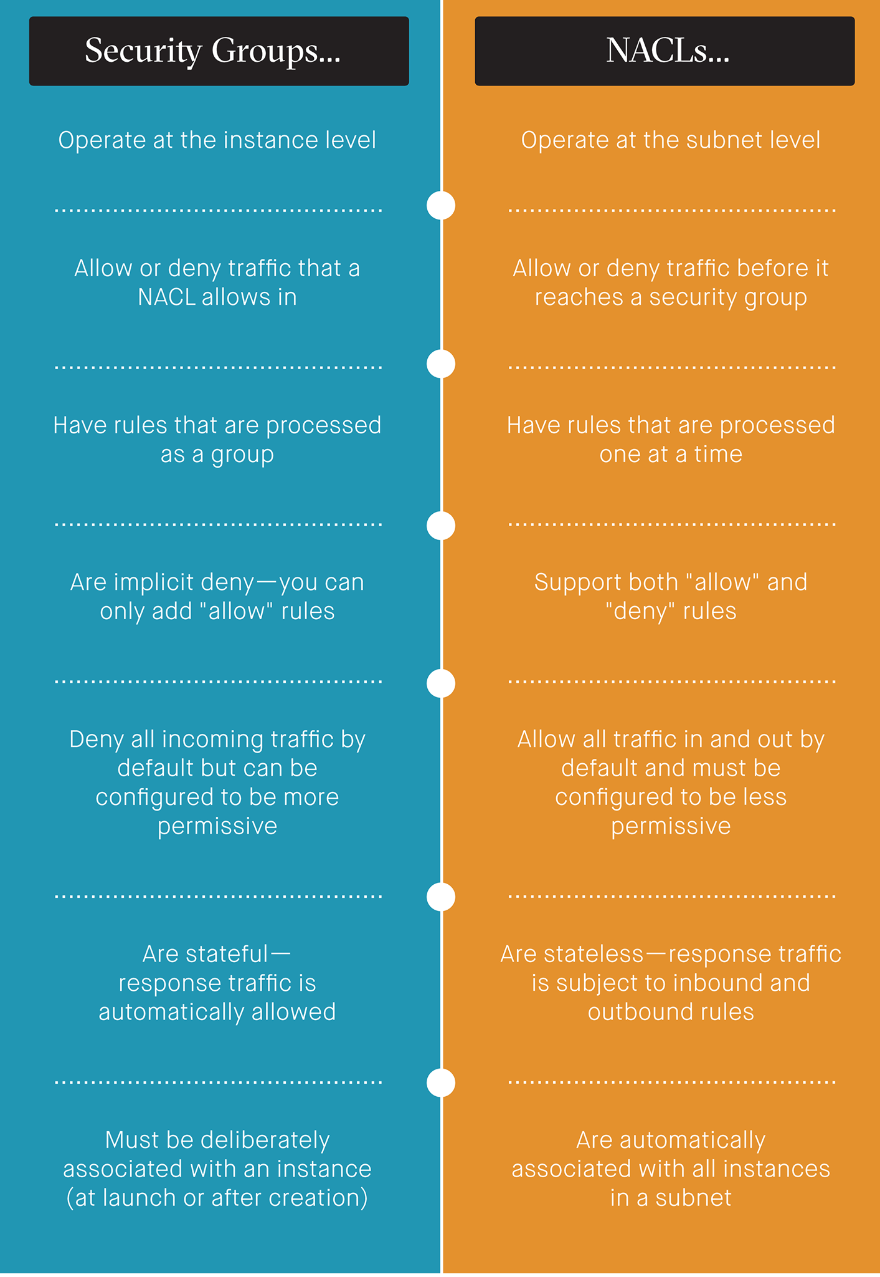

Slide 270
VPC Flow Logs
VPC flow logs is a feature that enables to capture information about the IP traffic going to and from network interfaces within a VPC. Flow log data is stored using Amazon CloudWatch logs and can be viewed and retrieved data in Amazon CloudWatch logs.
Flow logs can be created at three different levels:
VPC
Subnet
Network Interface Level
VPC Flow logs cannot be enabled for VPCs that are peered unless all of them lies on the same AWS account.

Slide 271
VPC Peering
A VPC peering connection is a networking connection between two VPCs that enables you to route traffic between them using private IPv4 addresses or IPv6 addresses.
Resources in either VPC can communicate with each other as if they are within the same network.
You can create a VPC peering connection between your own VPCs, or with a VPC in another AWS account. This allows VPC resources including EC2 instances, Amazon RDS databases and Lambda functions that run in different AWS Regions to communicate with each other using private IP addresses, without requiring gateways, VPN connections, or separate network appliances.

Slide 272
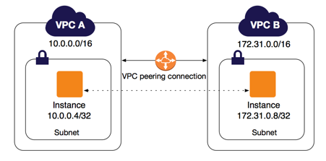
VPC Peering

Slide 273
VPC Peering
The traffic remains in the private IP space. All inter-region traffic is encrypted with no single point of failure, or bandwidth bottleneck.
Traffic always stays on the global AWS backbone, and never traverses the public internet, which reduces threats, such as common exploits, and DDoS attacks.

Slide 274
VPC Peering - Rules and Limitations
VPC peering connection cannot be created between VPCs that have matching or overlapping CIDR blocks.
VPC peering does not support transitive peering relationships. In a VPC peering connection, the VPC does not have access to any other VPCs that the peer VPC may be peered with even if established entirely within your own AWS account
Only one VPC peering connection can be established between the same two VPCs at the same time.

Slide 275
Bastion Hosts
Wikipedia definition:
“It's a special purpose computer on the network, specifically designed and configured to withstand attacks and the computer generally hosts a single application. For example, a proxy server, and all other services are removed or limited to reduce the threat to this computer. It is hardened in this manner, primarily due to its location and purpose, which is either on the outside of a firewall or inside a demilitarized zone (Basically Public Subnets).

Slide 276
Bastion Hosts
Bastion is a way of SSHing or RDPing in to private instances in the private subnets. You essentially just focus on hardening this Bastion host.
NAT Gateway or NAT instance is used to provide internet traffic to EC2 instances in private subnets.
A Bastion is used to securely administer EC2 instances, i.e using SSH or RDP.
NAT gateways cannot be used as a Bastion host.

Slide 277
VPC Endpoints
VPC endpoint enables creation of a private connection between VPC to supported AWS services and VPC endpoint services powered by PrivateLink using its private IP address.
.The communication doesn’t require an internet gateway and Nat device, a VPN connection, or an AWS Direct Connect connection.
Instances in the VPC do not require public IP addresses to communicate with resources in the service. So traffic between the VPC and other services does not leave the Amazon network.
Endpoints are virtual devices, and they are horizontally scaled, redundant, and highly available.

Slide 278
VPC Endpoints - Types
Types of VPC Endpoints
Interface endpoints
An elastic network interface or an ENI with a private IP address that serves as an entry point for traffic destined to a supported service.
You basically attach an ENI to an EC2 instance, and that will essentially allow you to communicate to these services using the Amazon internal network. They don't need to traverse the internet.
The services supported are: https://docs.aws.amazon.com/vpc/latest/userguide/integrated-services-vpce-list.html

Slide 279
VPC Endpoints - Types
Types of VPC Endpoints
Gateway endpoints
An elastic network interface with a private IP address from the IP address range of your subnet, powered by AWS PrivateLink.
Gateway endpoints support:
S3
DynamoDB

Slide 280
Sharing Applications across VPCs
Open up the VPC to the internet.
Security considerations; everything in the public subnet is public.
VPC Peering
Have to create and manage peering relationship with each one of the VPC.
The whole network will be accessible. This isn’t the best practice if there are multiple critical applications inside of the VPC.
VPC Peering is a viable option if the numbers of VPC is limited and can be managed without a lot of efforts.
Managing tens, hundreds, or thousands VPCs with VPC peering is not feasible.

Slide 281
Sharing Applications across VPCs
AWS PrivateLink
The best way to expose a service VPC to tens, hundreds, or thousand of customer VPCs.
Doesn’t require VPC Peering, no route tables, NAT, IGWs, etc.
Requires a Network Load Balancer on the service VPC and an ENI on the customer VPC.

Slide 282
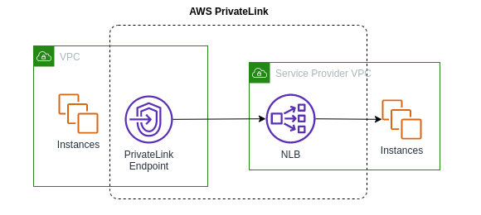
Sharing Applications across VPCs
Network load balancer is configured on Service VPC. In customer's VPC, and elastic network interface is configured, that is dedicated to the application or service. The static IP address of the network load balancer is then opened in elastic network interface by creating an AWS Private Link.

Slide 283
AWS Global Accelerator
AWS Global Accelerator is a networking service that sends user’s traffic through Amazon Web Service’s global network infrastructure, improving the internet user performance by up to 60%. When the internet is congested, Global Accelerator’s automatic routing optimizations will help keep packet loss, jitter, and latency consistently low.
With Global Accelerator, you are provided two global static IPs that acts as a fixed entry point to your application. On the backend, add or remove AWS application origins, such as Network Load Balancers, Application Load Balancers, Elastic IPs, and EC2 Instances, without making user facing changes. To mitigate endpoint failure, Global Accelerator automatically re-routes your traffic to your nearest healthy available endpoint.

Slide 284
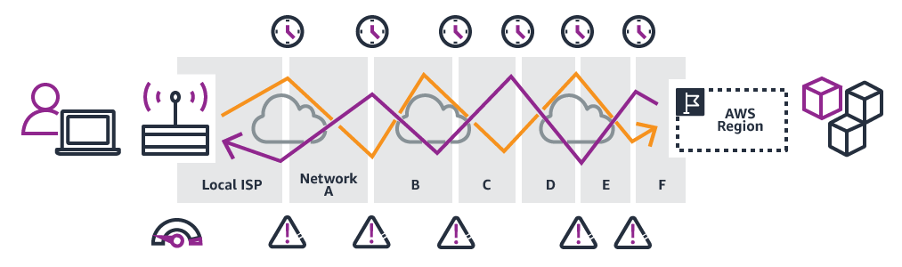
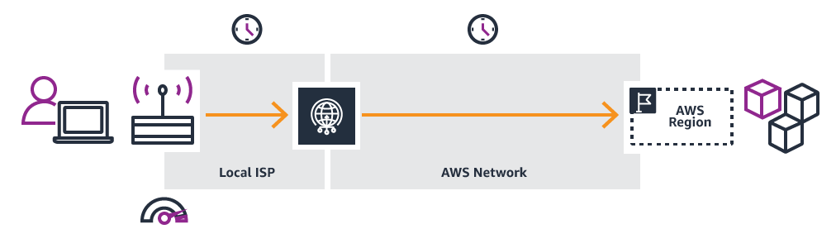
AWS Global Accelerator
Without Global Accelerator
With Global Accelerator

Slide 285
AWS Global Accelerator - Components
Static IP address
Listener
Endpoint Group
Endpoints

Slide 286
AWS Global Accelerator - Components
Static IP address
Global Accelerator provides you with two static IP addresses that you can associate with your accelerator or you can bring your own.
Listener
A listener processes inbound connections from the clients to Global Accelerator, based on the port or port ranges and protocols as configured.
Global Accelerator supports TCP and UDP protocols.
Each listener has one or more endpoint groups associated with it.

Slide 287
AWS Global Accelerator - Components
Endpoint groups
Endpoint groups is each endpoint group is associated with a specific AWS region.
Endpoint groups include one or more endpoints in the region, and the percentage of traffic could be increased or reduced by adjusting a setting called the traffic dial.
The traffic dial lets performance testing or blue-green deployments testing for new releases across different AWS regions.

Slide 288
AWS Global Accelerator - Components
Endpoints
Endpoints are things like network load balancers, application load balancers, EC2 instances or elastic IP addresses.
For each endpoint you can configure weights, and this can be useful, for example, to do things like performance testing within a particular region.

Slide 289
AWS Global Accelerator - Use case
Scale for increased application utilization
When application usage grows, the number of IP addresses and endpoints that needs to be managed also increase. Global Accelerator allows to scale network up or down. It lets you associate regional resources, such as load balancers and EC2 instances, to two static IP addresses.
Accelerate latency-sensitive applications
To improve the user experience, AWS Global Accelerator directs user traffic to the nearest application endpoint to the client, thus reducing internet latency and jitter. It routes the traffic to the closest edge location via Anycast, then by routing it to the closest regional endpoint over the AWS global network.

Slide 290
AWS Global Accelerator - Use case
Disaster recovery for multi-region & multi-Availability Zone resiliency
If AWS Global Accelerator detects failure of application endpoint in the primary AZ or AWS Region, it instantly triggers traffic re-routing to your application endpoint in the next available, closest endpoint in another AZ or AWS Region.
Protect your applications
When making Application Load Balancers or EC2 instances internet-facing, you also increase your exposure to attacks from the internet. AWS Global Accelerator allows to add an internal Application Load Balancer or a private EC2 instance as an endpoint.

Slide 291
AWS Global Accelerator - Use case
Protect your applications
By using AWS Global Accelerator as the single internet-facing access point, you protect the applications running on AWS from distributed denial of service (DDoS) attacks and control how your end users reach your applications.
AWS Global Accelerator creates a peering connection between the AWS Global Accelerator and Amazon VPC. The traffic between the two VPCs uses private IP addresses.

Slide 292
AWS Global Accelerator vs AWS CloudFront
AWS Global Accelerator and Amazon CloudFront are separate services that use the AWS global network and its edge locations around the world. Global Accelerator is a good fit for non-HTTP use cases, such as gaming (UDP), IoT (MQTT), or Voice over IP, as well as for HTTP use cases that specifically require static IP addresses or deterministic, fast regional failover.
Both services integrate with AWS Shield for DDoS protection.

Slide 293
AWS Direct Connect
AWS Direct Connect is a cloud service solution that makes it easy to establish a dedicated network connection from your premises to AWS. Using AWS Direct Connect, you can establish private connectivity between AWS and your datacenter, office, or colocation environment, which in many cases can reduce your network costs, increase bandwidth throughput, and provide a more consistent network experience than Internet-based connections.

Slide 294
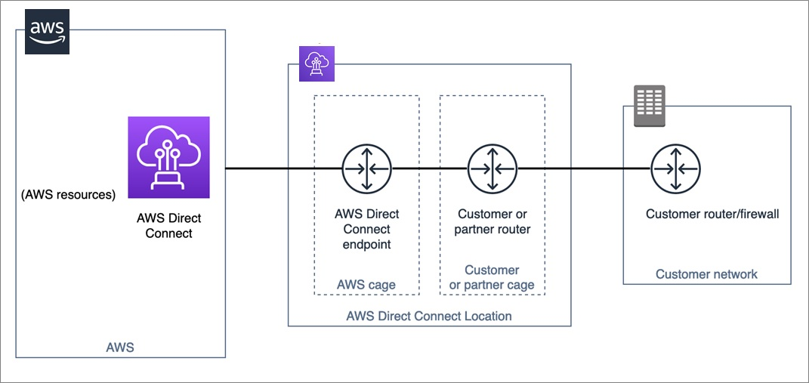
AWS Direct Connect

Slide 295
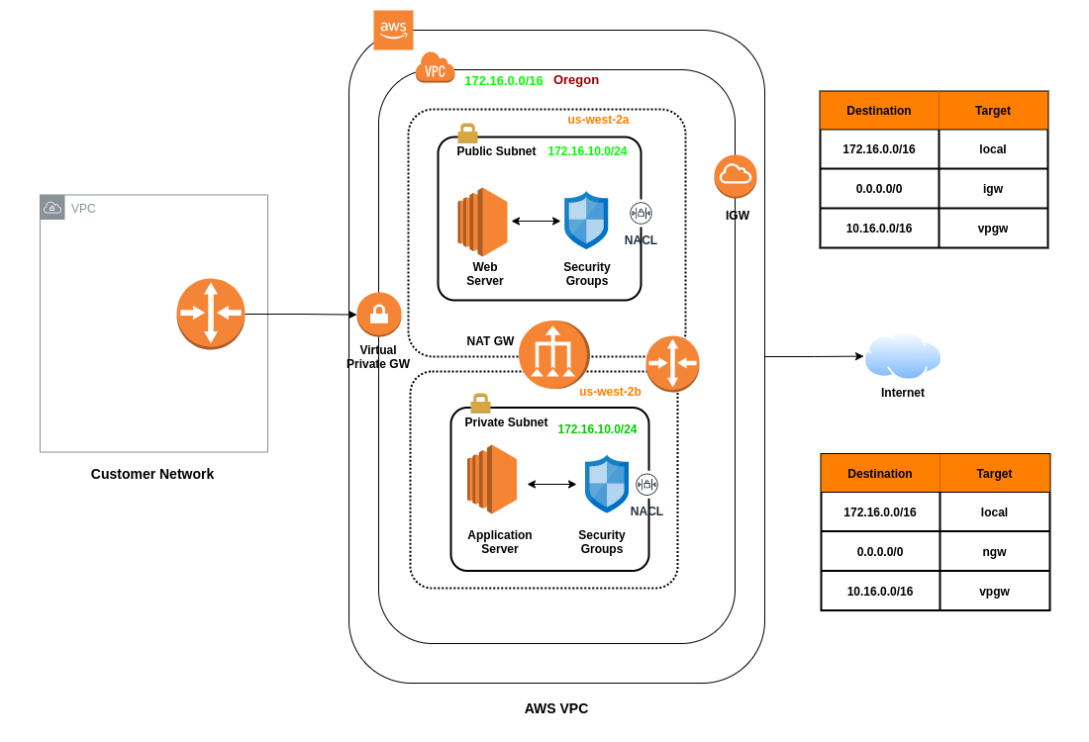
AWS Direct Connect

Slide 296
AWS Direct Connect - Benefits
Reduces bandwidth costs
Consistent Network performance
Compatible with all AWS services
Private connectivity to VPC.
Elastic

Slide 297
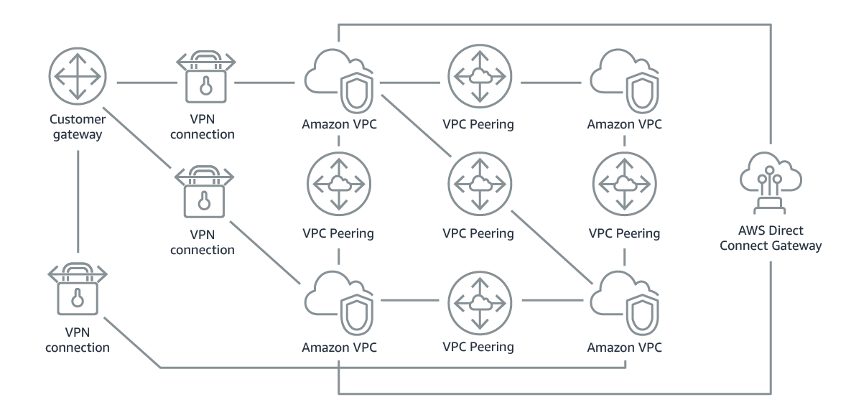
Network Architectures in an Organization

Slide 298
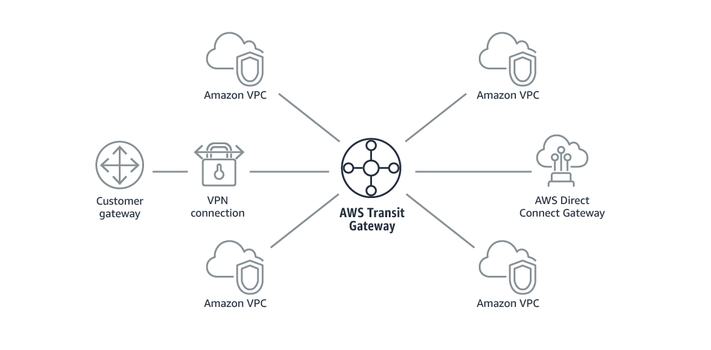
AWS Transit Gateway

Slide 299
AWS Transit Gateway
Simplifies the network topology.
Allows to have transitive peering between thousands of VPCs and on-premises data centers.
Operates on Hub and Spoke Model.
You can use route table to limit how VPCs talk to each other.
Works with Direct Connect as well as VPN connections.
Supports IP Multicast (not supported by any other AWS service)

Slide 300
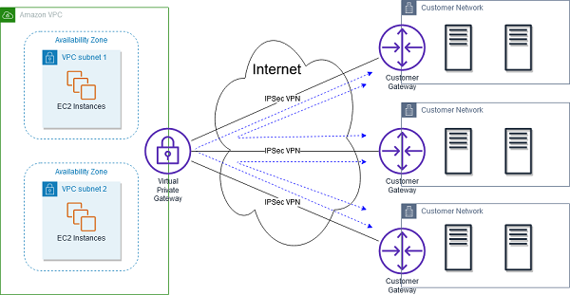
AWS VPN CloudHub

Slide 301
AWS VPN CloudHub
Hub and spoke architecture.
A single point of contact to connect the VPN infrastructures into.
If you have multiple sites each with its own VPN connection, you can use AWS VPN CloudHub to connect those sites together.
Operates over the public internet, but all traffic between the customer gateway and the AWS VPN CloudHub is encrypted.

Slide 302
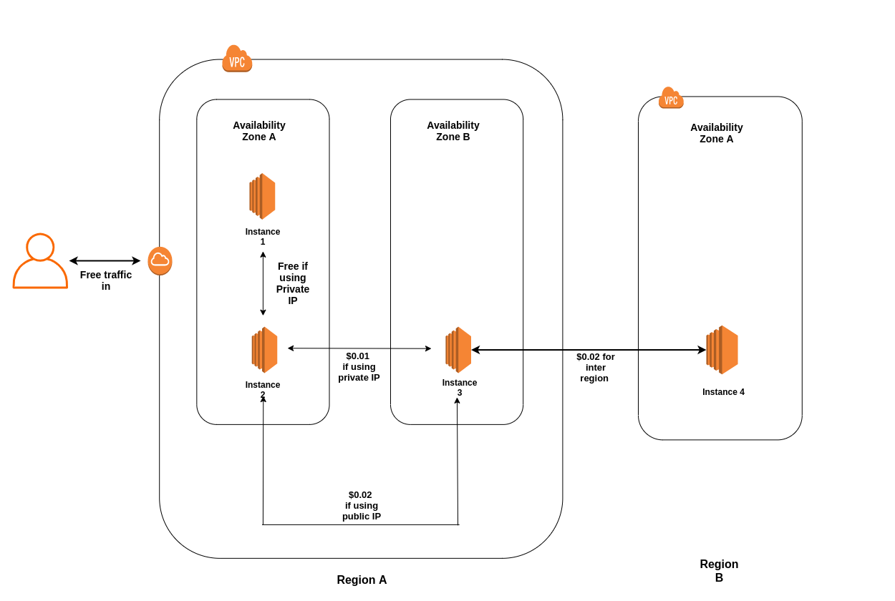
AWS Network costs

Slide 303
AWS Network costs
Use private IP addresses over public IP addresses where possible to save on costs; it utilizes the AWS backbone network.
Communication between two instances inside the same availability zone and use private IP addresses will be cost-free, but it will have a whole bunch of single points of failure issues. So if the availability zone goes down, the entire application is going to go down.

Slide 304
Chapter 7
Route 53
Route 53
DNS 101
Route53 record types
Routing Policies Available on AWS
Simple Routing Policy
Weighted Routing Policy
Latency-Based
Failover Routing Policy
Geolocation Routing Policy
Geoproximity Routing Policy
Multivalue Answer Policy

Slide 305
DNS - Domain Name System
The Domain Name System (DNS) is the like the phonebook of the Internet. Humans access information online through domain names, like nytimes.com or espn.com. Web browsers interact through Internet Protocol (IP) addresses. DNS translates domain names to IP addresses so browsers can load Internet resources.
AWS’s DNS service is called Route53.

Slide 306
Top Level Domains
The last word in a domain name represents the top-level domain.
google.com - .com is top level domain
The second word in a domain name is known as the second-level domain name, and this is optional, though, and it depends on the domain name.
google.com.np - Top level is .np and second-level is .com

Slide 307
Start of Authority (SOA) records
While registering a domain, every DNS record begins with Start of Authority record. The SOA record stores information about:
The name of the server that supplied the data for the zone.
The current version of the data file.
The default number of seconds for the Time-To-Live file on resource records.

Slide 308
NS - Name Server Records
An NS server is a database that holds the records for all DNS names.
NS record identifies the name servers for the hosted zone.
When a is created, you are presented with at least four name servers that has record of your domain.
When you type cubedsteps.com in your browser:
The browser sends a request to that domain’s nameservers
The nameservers respond back with the IP address of the website’s server
The browser requests the website content from that IP address
The browser retrieves the content and renders it in your browser

Slide 309
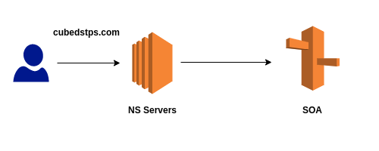
NS - Name Server Records

Slide 310
DNS record types
A records
Used to route traffic to a resource, such as a web server, using an IPv4 address.
AAAA records
Used to route traffic to a resource, such as a web server, using an IPv6 address.
CNAME records
A CNAME record maps DNS queries for the name of the current record, such as facebook.com, to another domain (fb.com).
Alias records
Used to map resource record sets in a hosted zone to ELB. Cloudfront distributions or S3 buckets that are configured as websites.

Slide 311
DNS record types
MX records
An MX record specifies the names of your mail servers.
PTR record type
A PTR record maps an IP address to the corresponding domain name.

Slide 312
Routing policies available on AWS
Simple Routing
Weighted Routing
Latency-based Routing
Failover Routing
Geolocation Routing
Geoproximity Routing (Traffic Flow Only)
Multivalue Answer Routing

Slide 313
Routing policies available on AWS
Simple Routing
Weighted Routing
Latency-based Routing
Failover Routing
Geolocation Routing
Geoproximity Routing (Traffic Flow Only)
Multivalue Answer Routing

Slide 314
Routing policies - Simple Routing
You can only have one record with multiple IP addresses
If you specify multiple values in a record, Route 53 returns all values to the user in a random order.

Slide 315
Routing policies - Weighted Routing
Allows to split the traffic based on different weights assigned.
For example, you can set 10% of the traffic to one region and rest of the 90% to another.
Health checks can be configured for Weighted Routing policy.

Slide 316
Routing policies - Weighted Routing
Allows to split the traffic based on different weights assigned.
For example, you can set 10% of the traffic to one region and rest of the 90% to another.
Health checks can be configured for individual record sets for Weighted Routing policy.
If a record set fails a health check, it will be removed for Route53 until it passes the health check.

Slide 317
Routing policies - Latency-Based Routing
Latency-based routing allows to route the traffic based on the lowest network latency for end users.
Route53 evaluates the latency to the servers from users location and sends the request to the server that has the lowest latency.

Slide 318
Routing policies - Failover Routing
Failover routing policies are used when you want to create an active/passive set up. For example, setting a primary site on one region and secondary/DR site on another.
Route53 monitors the health of primary site using health check. In case the primary site fails, route53 automatically fails over to the secondary site.

Slide 319
Routing policies - Geolocation Routing
Allows to choose where the traffic is to be sent based on the geographic location of the users.
Can be useful in cases where the contents are region specific.
The Route53 response is independent of the latency and always responds with the record set that is geographically close.

Slide 320
Routing policies - Geoproximity Routing
Allows to route traffic based on the location of your resources and, optionally, shift traffic from resources in one location to resources in another.
A use case for Geoproximity may be if you have more resources/bigger instance size in a particular region, hence why you would want to direct users to that region over the other.

Slide 321
Routing policies - Multivalue Answer Routing
Allows to configure Route53 to return multiple values, such as IP addresses for web servers, in response to DNS queries.
Similar to simple routing, however it allows to put health check on each record set.

Slide 322
Chapter 7
HA Architecture
Elastic Load Balancers
Load Balancers and Health Checks
Advanced Load Balancer Theory
Auto Scaling
Launch Configurations and Auto Scaling Groups
HA Architecture
Elastic Beanstalk
HPC on AWS
On-Premises Strategies with AWS
CloudFormation

Slide 323
Load Balancers
A load balancer serves as the single point of contact of your applications.
Elastic Load Balancing automatically distributes incoming application traffic across multiple targets, such as Amazon EC2 instances, containers, IP addresses, Lambda functions, and virtual appliances. It can handle the varying load of your application traffic in a single Availability Zone or across multiple Availability Zones.
Can be internet facing or internal.
The internet facing Load Balancers always require two public subnets and internal facing private ones.

Slide 324
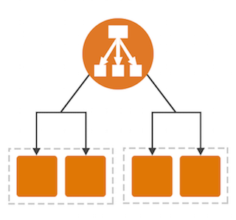
Load Balancers

Slide 325
Load Balancer Components
Application Load Balancer
A load balancer serves as the single point of contact of your applications and automatically distributes incoming application traffic across multiple targets.
Target Groups
Target groups are used to route requests to one or more registered targets. When you create each listener rule, you specify a target group and conditions. When a rule condition is met, traffic is forwarded to the corresponding target group.

Slide 326
Load Balancer Components
Health Checks
You can define health check settings for your load balancer on a per target group basis. Each target group uses the default health check settings, unless you override them when you create the target group or modify them later on.
Listener
Listeners belonging to Load Balancers check for connection requests using the protocol and port you configure. Each listener must include a default action to ensure all requests are routed. Once you have created your listener, you can create and manage additional routing rules as needed

Slide 327
How Load Balancers work?
A load balancer accepts incoming traffic and routes requests to its registered targets (such as EC2 instances) in one or more Availability Zones. The load balancer also monitors the health of its registered targets and ensures that it routes traffic only to healthy targets. When the load balancer detects an unhealthy target, it stops routing traffic to that target. It then resumes routing traffic to that target when it detects that the target is healthy again.

Slide 328
How Load Balancers work?
A listener checks for connection requests from clients, using the protocol and port that you configure. The rules that you define for a listener determine how the load balancer routes requests to its registered targets.
Each target group routes requests to one or more registered targets, such as EC2 instances, using the protocol and port number that you specify. You can register a target with multiple target groups. You can configure health checks on a per target group basis. Health checks are performed on all targets registered to a target group that is specified in a listener rule for your load balancer.

Slide 329
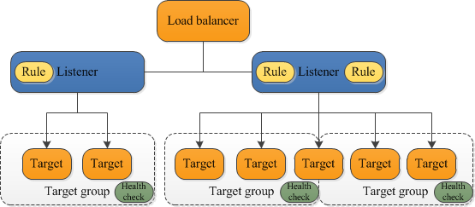
How Load Balancers work?

Slide 330
Load Balancer types
Classic Load Balancer
Legacy Elastic Load Balancers.
Can load balance HTTP and HTTPS applications and use Layer 7-specific features, such as X-Forwarded-For and sticky sessions, but it's not application-aware.
Always prefer Application load balancers over Classic Load Balancers.

Slide 331
Load Balancer types
Application Load Balancer
Best suited for load balancing of HTTP and HTTPS traffic.
Operate at Layer 7 and are application-aware.
Network Load Balancer
Best suited for the load balancing of TCP traffic where extreme performance is required.
Operates at Layer 4, are capable of handling millions of requests per second while maintaining ultra-low latencies.
https://www.nginx.com/resources/glossary/layer-7-load-balancing/

Slide 332
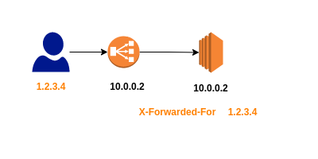
X-Forwarded-For Header
Used to view the IPv4 address where the request is originating from.

Slide 333
Sticky sessions
A Load Balancer routes each request independently to the registered EC2 instance with the smallest load.
Sticky sessions allows to bind a user's session to a specific EC2 instance and this ensures that all requests from the user during the session are sent to the same instance.

Slide 334
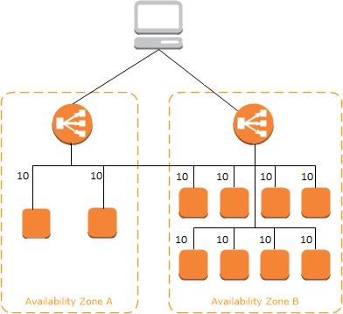
Cross Zone Load Balancing
Spread traffic uniformly across multiple availability zones within a region.

Slide 335
Path Patterns
You can create a listener with rules to forward requests based on the URL path and this is known as path-based routing.
For example, you can route general requests to one target group and requests to render images to another target group.

Slide 336
Auto Scaling
AWS Auto Scaling monitors your applications and automatically adjusts capacity to maintain steady, predictable performance at the lowest possible cost.

Slide 337
Auto Scaling - Components
Groups
Logical group of related resources; Webserver group or Application group or Database group.
Configuration Templates
Groups uses a launch template or a launch configuration as a configuration template for its EC2 instances. You can specify information such as AMI ID, instance type, Key Pair, Security Groups and block mapping for your instances.

Slide 338
Auto Scaling - Components
Scaling Options
Specifies when to trigger scaling of Auto Scaling groups based on the occurrence of specified conditions (dynamic scaling) or on a schedule.

Slide 339
Launch Configurations vs Launch Templates
A launch configuration is an instance configuration template that an Auto Scaling group uses to launch EC2 instances. When you create a launch configuration, you specify information for the instances; AMI ID, the instance type, a key pair, one or more security groups, and a block device mapping.
You can specify your launch configuration with multiple Auto Scaling groups. However, you can only specify one launch configuration for an Auto Scaling group at a time, and you can't modify a launch configuration after you've created it. To change the launch configuration for an Auto Scaling group, you must create a launch configuration and then update your Auto Scaling group with it.

Slide 340
Launch Configurations vs Launch Templates
A launch template is similar to a launch configuration, in that it specifies instance configuration information; AMI ID, the instance type, a key pair, security groups, and the other parameters that you use to launch EC2 instances.
However, defining a launch template instead of a launch configuration allows you to have multiple versions of a template. With versioning, you can create a subset of the full set of parameters and then reuse it to create other templates or template versions. For example, you can create a default template that defines common configuration parameters and allow the other parameters to be specified as part of another version of the same template.

Slide 341
Launch Configurations vs Launch Templates
You cannot create an Auto Scaling group that launches both Spot and On-Demand Instances or that specifies multiple instance types. You must use a launch template to configure these features.
You are allowed to add multiple instance types instead of one single type so for example you have specific workload you can run fixed number of instances as on-demand or reserved and any extra workload to be fired on spot instances.
In addition to the features of Amazon EC2 Auto Scaling that you can configure by using launch templates, launch templates provide more advanced Amazon EC2 configuration options. You must use launch templates to use Amazon EC2 Dedicated Hosts.

Slide 342
Launch Configurations vs Launch Templates
When you want to include instances with multiple purchase types in the same auto scaling group, you have the ability to maintain a set number of on-demand instances will be deployed at all times, and then split the remaining instances between multiple purchase types as you see fit. To configure this, set a number of instances as your "optional on-demand base" within your launch template. This is not possible using a launch configuration.

Slide 343
Scaling Options - Maintain current instance levels at all times
You can configure your auto scaling groups to maintain a specified number of running instances at all times.
To maintain the current instance levels Amazon EC2 auto scaling performs a periodic health check on your instances within an auto scaling group.
When it finds an unhealthy instance, it terminates that instance and then launch a new one.

Slide 344
Scaling Options - Manual Scaling
With manual scaling you specify only the change in the maximum, minimum or desired capacity of your auto scaling group and Amazon EC2 auto scaling manages the process of creating or terminating instances to maintain the updated capacity.

Slide 345
Scaling Options - Scale based on a schedule
With scaling based on a schedule, the scaling actions are performed automatically as a function of date and time.
This is useful when the schedule to increase or decrease the number of instances in the group is already known.

Slide 346
Scaling Options - Scale based on demand
Scaling based on demand allows to define the parameters that control the scaling process.
For example, you have a web application that currently runs on two instances and you want the CPU utilization of the auto scaling group to stay at around 50% when the load on the application changes. This can be configured using Scale based on demand.
This method is useful for scaling in response to changing or unknown conditions.

Slide 347
Scaling Options - Predictive Scaling
Predictive scaling allows to maintain optimal availability and performance by combining predictive scaling and dynamic scaling, (proactive and reactive approaches respectively,) to scale your EC2 instances capacities faster.

Slide 348
HA Sample Question
You have a website that requires a minimum of six instances and it must be highly available. You must also be able to tolerate the failure of one availability zone. What is the ideal architecture for this environment while being the most cost effective?
2 Availability zones with 2 instances in each AZ.
3 Availability zones with 3 instances in each AZ.
1 Availability zones with 6 instances.
3 availability zones with 2 instances in each AZ.

Slide 349
Infrastructure as Code (IaC)
Infrastructure as Code (IaC) is a method to provision and manage IT infrastructure through the use of source code, rather than through standard operating procedures and manual processes.
IaC helps you automate the infrastructure deployment process in a repeatable, and consistent manner.

Slide 350
Infrastructure as Code (IaC) - Benefits
Speed and simplicity
IaC allows you to spin up an entire infrastructure architecture by running a script.
Not only can you deploy virtual servers, but you can also launch pre-configured databases, network infrastructure, storage systems, load balancers, and any other cloud service that you may need.
You can create multiple environment with the same set of code. The same code can be used for Backup and Disaster Recovery as well.

Slide 351
Infrastructure as Code (IaC) - Benefits
Configuration consistency
Standard operating procedures can help maintain some consistency in the infrastructure deployment process.
Cost savings
IaC script can automatically spin down environments when they’re not in use, which will further save on cloud computing costs.

Slide 352
AWS CloudFormation
AWS CloudFormation is a configuration orchestration tool that allows you to codify your infrastructure to automate your deployments.
Instead of creating an infrastructure with a bunch of AWS API calls, wait loops, and retry logic, you just describe what you want to CloudFormation and it will do it for you.
There’s no charge associated with using CloudFormation. The charge are incurred for the created instances only.

Slide 353
AWS Elastic Beanstalk
Elastic Beanstalk allows to quickly deploy and manage applications in the AWS cloud without worrying about the infrastructure that runs those applications.
You simply upload your application (Code) and Elastic Beanstalk will automatically handle the details of capacity provisioning, load balancing, scaling, application, health monitoring, et cetera.

Slide 354
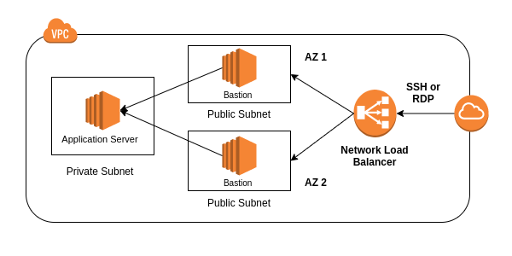
High Availability with Bastion Hosts

Slide 355
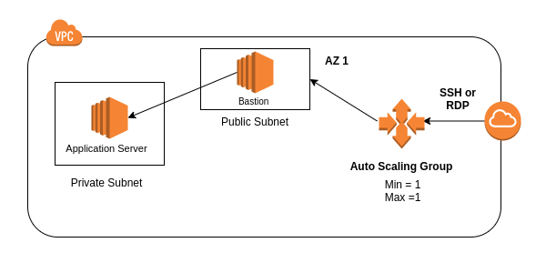
High Availability with Bastion Hosts

Slide 356
HPC on AWS
High Performance Computing most generally refers to the practice of aggregating computing power in a way that delivers much higher performance than one could get out of a typical desktop computer or workstation in order to solve large problems in science, engineering, or business.
High-performance computing (HPC) is the ability to process data and perform complex calculations at high speeds.

Slide 357
Achieving HPC on AWS
Data Transfer
Compute and Networking
Storage
Orchestration and Automation

Slide 358
Achieving HPC on AWS - Data Transfer
Snowball/Snowmobile(Terabytes/Petabytes) of data.
AWS Datasync to store on S3, EFS, FSx for windows, etc.
Direct Connect

Slide 359
Achieving HPC on AWS - Compute & Networking
EC2 instances that are GPU or CPU optimized.
EC2 fleets
Placement groups (Cluster placement groups)
Enhanced Networking
Elastic Network Adapters
Elastic Fabric Adapters

Slide 360
Achieving HPC on AWS - Storage
Instance attached Storage
EBS scales up to 64,000 IOPS with provisioned IOPS.
Instance store for ephemeral workloads, can scale to millions of IOPS with low latency.
Network attached Storage
Amazon S3: distributed object based storage is not a file system.
Amazon EFS scales IOPS based on the total size of the file system, or you can also use provisioned IOPS with EFS.
Amazon FSX for Lustre, HPC optimized distributed file system gives millions of IOPS, also backed by S3.

Slide 361
Achieving HPC on AWS - Orchestration and Automation
AWS Batch
This enables developers, scientists and engineers to easily and efficiently run hundreds of thousands of batch computing jobs on AWS.
AWS batch supports multi-node parallel jobs, which allows you to run a single job that spans multiple EC2 instances and you can easily schedule your jobs and launch EC2 instances according to your needs.

Slide 362
Achieving HPC on AWS - Orchestration and Automation
AWS ParallelCluster
AWS parallel cluster and this is an open source cluster management tool that makes it easy for you to deploy and manage HPC clusters on AWS.
Uses a simple text file to model and provision all the resources needed for your HPC applications in an automated and secure manner and it allows you to automate the creation of VPCs, subnets, cluster types and instance types

Slide 363
VM Import/Export
VM Import/Export can be used to:
Migrate existing application into EC2.
Export your AWS VMs to your on-premises data center

Slide 364
Chapter 8
Applications
Simple Queuing System (SQS)
Simple Notification Service (SNS)
API Gateway
Kinesis
Web Identity Federation and Cognito
Event Processing Patterns

Slide 365
SQS
A web service that gives you access to a message queue that can be used to store messages while waiting for a computer to process them.
It's a distributed queue system that enables web service applications to quickly and reliably queue messages that one component in the application generates to be consumed by another component.
Queue is a temporary repository for messages that are awaiting processing.

Slide 366
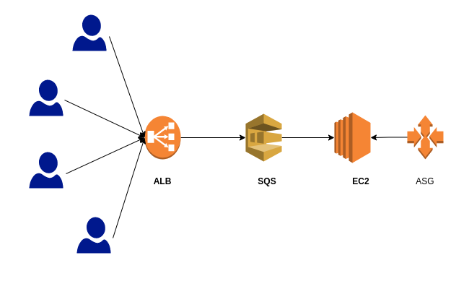
SQS

Slide 367

SQS

Slide 368
SQS
Amazon SQS can be used to decouple the components of an application so they run independently, easing message management between components.
Messages can contain up to 256 kilobytes of text in any format, and any component can later retrieve the messages programmatically using the Amazon SQS API.
The queue acts as a buffer between components producing and saving data, and the component receiving the data for processing. This means that the queue resolves issues that arise if the producer is producing work faster than the consumer can process it.

Slide 369
SQS - Types
Standard Queues (Default Queue type)
Lets you have nearly unlimited number of transactions per second.
Guarantees that a message is delivered at least once, and occasionally because of the highly-distributed architecture that allows the high throughput, more than one copy of the message might be delivered and it might be delivered out of order.
However, standard queues provide the best effort ordering which ensures that messages are generally delivered in the same order that they're sent.

Slide 370
SQS - Types
Your application needs to be able to cope with;the message being delivered out of order and, multiple copies of the same message being delivered twice.
FIFO Queues
FIFO, first-in-first-out ensures exactly once processing.
The order in which the messages are sent and received is strictly preserved and a message is delivered once and remains available until a consumer processes and deletes it.
Duplicates are not introduced into the queue.
FIFO queues are limited to 300 transactions per second, but have all the capabilities of standard queues.

Slide 371
SQS - FYIs
SQS is pull based, not push based.
Messages are 256 KB in size.
Messages can be kept in the queue from 1 minute to 14 days, the default retention period is 4 days.

Slide 372
SQS - FYIs
Visibility timeout
Visibility timeout is the amount of time that the messages is invisible in the SQS queue after a reader picks up that message.
Provided the job is processed before the visibility timeout expires, the message will be deleted from the queue. However, if the job is not processed within that time, then the message will become visible again and another reader will process it. This could result in the same message being delivered twice.
Visibility timeout maximum is 12 hours.

Slide 373
SQS - FYIs
Amazon SQS long polling is a way to retrieve messages from your SQS queues.
While the regular short polling returns immediately even if the message queue is being polled as empty, long polling doesn't return a response until messages arrive in the message queue or the long poll times out.

Slide 374
Simple Notification Service - SNS
A web service that allows to send notifications from the cloud.
SNS can deliver notifications by SMS text messages or by email to Amazon SQS, or to any HTTP endpoint.
SNS Topics

Slide 375
SNS vs SQS
Both messaging services in AWS.
SNS is push based while SQS is Poll (Pull) based.

Slide 376
API - Application Program Interface
Used by microservices to talk to each other.
Structured request and response.
Endpoints
The URL/URI where api/service can be accessed by a client application.
https://www.mydomain.com/api/users
GET https://www.mydomain.com/api/users
POST https://www.mydomain.com/api/users
https://www.youtube.com/watch?v=Q-BpqyOT3a8

Slide 377

API

Slide 378
AWS API Gateway
Basically a doorway into the AWS environment.
A fully managed service that allows to publish, maintain, monitor and scale APIs at any scale.
API Gateway has caching capabilities to improve performance.
API Gateway scales automatically.
You can throttle API Gateway to prevent attacks.

Slide 379

API Gateway

Slide 380
API Gateway Caching
API caching allows to cache the endpoint’s response.
With caching, you can reduce the number of calls made to your endpoint and also improve the latency of requests to your API.
When you enable caching, API Gateway caches responses from your endpoints for a specified time-to-live or TTL period, API Gateway responds to the requests by looking up the endpoint response from the cache instead of making the request to your endpoint.

Slide 381
API Gateway vs Application Load Balancer
Authentication and Authorization: API Gateway has a robust set of features surrounding auth and auth. For example:
Token-based authentication
Resource-based permissions
Integration with IAM for controlling access to the API
Custom authorizers that handle authorization and define custom IAM policies that the API function will run with.
API Gateway leans towards serverless architecture (Lambda, SNS) while Load balancer leans towards EC2 and target groups.

Slide 382
Streaming data
Streaming Data is data that is generated continuously by thousands of data sources, which typically send in the data records simultaneously, and in small sizes (order of Kilobytes).
Purchases from online stores
Game data
Geospatial data (think google maps)
IOT sensor data

Slide 383
Kinesis
Kinesis is a platform on AWS to send your streaming data to.
Kinesis makes it easy to load and analyze streaming data, and also providing the ability for you to build your own custom applications for your business needs.
Types of Kinesis
Kinesis Streams
Kinesis Firehose
Kinesis Analytics

Slide 384

Kinesis Streams

Slide 385

Kinesis Streams

Slide 386
Kinesis Streams
The producers continually push data to Kinesis Data Streams, and the consumers process the data in real time. Consumers (such as a custom application running on Amazon EC2 or an Amazon Kinesis Data Firehose delivery stream) can store their results using an AWS service such as Amazon DynamoDB, Amazon Redshift, or Amazon S3.

Slide 387
Kinesis Streams
Retention Period is the length of time that data records are accessible after they are added to the stream. A stream’s retention period is set to a default of 24 hours after creation. A retention period could be 24 hours to 7 days.
Producer put records into Amazon Kinesis Data Streams.
Consumer get records from Amazon Kinesis Data Streams and process them.

Slide 388
Kinesis Streams
Shard is a uniquely identified sequence of data records in a stream. A stream is composed of one or more shards, each of which provides a fixed unit of capacity. The data capacity of your stream is a function of the number of shards that you specify for the stream. The total capacity of the stream is the sum of the capacities of its shards.
Partition Key is used to group data by shard within a stream. Kinesis Data Streams segregates the data records belonging to a stream into multiple shards. It uses the partition key that is associated with each data record to determine which shard a given data record belongs to.

Slide 389
Kinesis Firehose
Amazon Kinesis Firehose is the easiest way to load streaming data into AWS. It can capture and automatically load streaming data into Amazon S3 and Amazon Redshift, enabling near real-time analytics with existing business intelligence tools and dashboards. It enables you to quickly implement an ELT approach, and gain benefits from streaming data quickly.

Slide 390

Kinesis Firehose

Slide 391
Kinetics Streams Vs Kinesis Firehose
Kinesis Streams stores the data in the stream. You should setup consumers to do something with it. So a lambda function and an EC2 instance can be reading from that stream at the same time and generating something or transforming data. Then an action can be taken, like send someone a message or store data in S3.
Kinesis Firehose is meant to be used when you want to collect streaming data and process them on the fly, without waiting for the complete dataset.

Slide 392
Kinetics Analytics
Amazon Kinesis Analytics is the easiest way to process streaming data in real time with standard SQL without having to learn new programming languages or processing frameworks.
Amazon Kinesis Analytics enables you to query streaming data or build entire streaming applications using SQL, so that you can gain actionable insights and respond to your business and customer needs promptly.

Slide 393

Kinesis Analytics

Slide 394
Web Identity Federation & Cognito
Web Identity Federation lets you give your users access to AWS resources after they have successfully authenticated with a web-based identity provider like Amazon, Facebook, or Google.
Following the successful authentication, the user receives an authentication code from the web ID provider, which they then trade for temporary AWS security credentials.

Slide 395
Cognito User pools
User Pools are user directories and they're used to manage sign up and sign-in functionality for mobile and web applications.
Users can sign in directly to the User Pool. This means their username and password is basically stored within Cognito itself, or they can go ahead and use a third-party identity broker like Facebook, Amazon, or Google.
Identity Pools is the actual granting of authentication to your AWS resources.
Identity pools maps the user token generated from User pools and assigns an IAM role with related permissions. Using this role, the user can then log in into the AWS environment.

Slide 396

AWS Cognito
AWS Cognito provides Web identity Federation.

Slide 397
Event Processing Patterns
Architecture where one or more AWS services will automatically perform work in response to events triggered by other AWS services.
Event driven Architecture
Pub/Sub Messaging
Dead Letter Queues (DLQ)
Fanout pattern
S3 Events notifications

Slide 398
Pub/Sub Messaging
Allows message to be broadcasted to different parts of a system asynchronously.
Publisher pushes the message to the topic.
Subscribers subscribed to the topic asynchronously receives the message.
Each subscriber can do something different with the message that is delivered.
Publisher doesn’t need to know who is using the information and the Subscriber doesn’t need to know who sent the message.

Slide 399

Pub/Sub Messaging

Slide 400
Pub/Sub Messaging - Dead Letter Queues (DLQ)
Sometimes messages are inspected for potential redelivery, or sometimes it'll just stay there forever, unclaimed. Those messages can be handled appropriately using Dead Letter Queues (DLQ)
AWS services that use dead letter queues are:
SNS
Messages published to a topic can be sent in case those messages can't be delivered to a subscribed endpoint messages that can't be delivered due to client errors or server errors are held in the dead letter queue for further analysis or reprocessing.

Slide 401
Pub/Sub Messaging - Dead Letter Queues (DLQ)
SQS
Messages sent to SQS that exceed the queue’s manReceivecount are sent to DLQs
Lambda
Result from the failed asynchronous invocations will retry twice and send to either SQS queue or SNS topic.

Slide 402
Pub/Sub Messaging - Dead Letter Queues (DLQ)
Messages in the dead letter queue are the cases when normal error handling and retries have all failed.
The dead letter queue is a list of issues that need attention. It could indicate bugs, or it could indicate exceptional situations that your code isn't designed to handle.

Slide 403

Dead Letter Queues (DLQ)

Slide 404

Fanout Pattern

Slide 405
S3 Event Notifications
Enables to create notification when certain events happen in a bucket.
Notifications can be delivered to SQS Queue, SNS Topic or a Lambda Function.

Slide 406
Chapter 9
Security
Reducing Security Threats
Key Management Service (KMS)
CloudHSM
Systems Manager Parameter Store
Secrets Manager
Web Application Firewall (WAF)
AWS Shield

Slide 407
Reducing security threats
Security at transit
NACL
Host based Firewalls - Firewalld, UFW, iptables, Windows Firewall
Security Groups
NACL + ALB + Security Groups --> Security from IP or a groups of IPs
WAF
WAF + ALB --> Security from Common web attacks
WAF + CloudFront
AWS Shield

Slide 408
Reducing security threats
Security at Rest
Encryption on AWS - KMS, AES-256, SSE-S3
CloudHSM
Parameter Store
Secrets Manager
Access Management
Resource Policies
Identity Policies

Slide 409
AWS Key Management Service - KMS
A regional managed service that makes it easy for you to create and control the encryption keys use to encrypt your data.
KMS manages Customer Managed Keys (CMKs).
Other encryption management services on AWS are AWS Managed Keys and Customer Owned Keys.
Integrated with most AWS services
Key Access and Management permissions can be managed using IAM
Pay per API call.
Supports audit capability using CloudTrail.
FIPS 140-2 Level 2

Slide 410
Symmetric Vs Asymmetric CMKs
When you create a customer master key in KMS, by default, you get a symmetric CMK. This is where the same key is used for both encryption and decryption.
The encryption algorithm is based on the AES-256 standard.
Used to generate data keys, data key-pairs and random string bytes.
An asymmetric CMK represents a mathematically related public key and private key pair.
Asymmetric CMKs are based on the RSA and elliptic curve cryptography algorithms.
Public key is downloaded and used outside of AWS.
Sign messages and verify signatures.

Slide 411
Hardware Security Model (HSM)
A physical computing device that safeguards and manages digital keys, performs encryption and decryption functions for digital signatures, strong authentication and other cryptographic functions. These modules traditionally come in the form of a plug-in card or an external device that attaches directly to a computer or network server.
HSMs are used for real time authorisation and authentication in critical infrastructure thus are typically engineered to support standard high availability models including clustering, automated failover, and redundant field-replaceable components.
HSM is like a safe inside a Network that stores the key to unlock your data.
For every transaction, the key is accessed from HSM.

Slide 412
CloudHSM
Dedicated hardware security module (HSM)
Manage your own keys
No access to AWS managed component.
Runs within a VPC within an account.
Single tenant, dedicated hardware, multi AZ cluster.
Used for regulatory compliance requirement.
FIPS 140-2 Level 3

Slide 413

CloudHSM Architecture

Slide 414
System Manager Parameter Store
A serverless scalable and high performance system for storing data and secrets
Passwords
Database connection strings
License codes
API keys, and so on.
Values can be encrypted using KMS or in plain text.
Separate data from source control
Store parameters in hierarchies
Track versions

Slide 415

Parameter Store Hierarchies

Slide 416
Secrets Manager
A service that helps you rotate, manage and retrieve secrets, like database credentials, API keys and so on.
Similar to Parameter Store except
Use of Parameter Store is free while Charge per secret stored and per 10,000 API calls.
Automatically rotate keys.
Apply new key/password in RDS for you.
Generate random secrets on the fly.

Slide 417
Web Application Firewall (WAF)
AWS WAF is a web application firewall that lets you monitor the HTTP and HTTPS requests that are forwarded to an Amazon CloudFront distribution, an Amazon API Gateway or an Application Load Balancer.
Controls access to the content based on the conditions specified.
Configure filtering rules to allow/deny traffic.
IP addresses
Query string parameters
SQL Query injection

Slide 418
Web Application Firewall (WAF)
At the simplest level, AWS WAF lets you choose one of the following behaviors:
Allow all requests except the ones that you specify.
Block all requests except the ones that you specify
Count the requests that match the properties that you specify

Slide 419
Web Application Firewall (WAF)
Request properties
Originating IP address
Originating country
Request size
Value in request headers
Strings in request matching regular expressions (regex) patterns
SQL code (injection)
Cross site scripting (XSS)

Slide 420
AWS Shield
AWS Shield can help protect against denial of service (DDoS) attacks. DDoS is a malicious attempt to affect the availability of a targeted system, such as a website or an application to legitimate end-users.
Tiers of Shield services:
AWS Shield Standard
When using WAF, automatically enabled for all customers at no cost.
Protect against common layer 3 and layer 4 attacks.
SYN/UDP Floods
Reflection Attacks

Slide 421
AWS Shield
Tiers of Shield services:
AWS Shield Advanced
Adds additional features on top of AWS WAF, such as dedicated support from the DDoS Response Team (DRT) and advanced reporting.
$3000 per month per org
Enhanced protection for EC2, ELB, CLoudFront, Global Accelerator, Route53, etc.

Slide 422
WAF Vs Shield
AWS WAF "Firewall" can handle different types of attack, AWS Shield is handling only DDOS attack.
AWS WAF controls which traffic to allow or block to your web application by defining customizable web security rules. AWS WAF is a web application firewall that helps protect your web applications from common web exploits that could affect application availability, compromise security, or consume excessive resources.
AWS Shield manages DDoS Protection. AWS Shield is a managed Distributed Denial of Service (DDoS) protection service that safeguards web applications running on AWS.

Slide 423
Chapter 9
Serverless
Lambda
Elastic container Service (ECS)

Slide 424
AWS Lambda
AWS Lambda is a compute service where you can upload your code and create Lambda functions.
AWS Lambda takes care of provisioning and managing the servers that you use to run the code.
User doesn't have to worry about operating systems, patching, scaling, et cetera, et cetera.

Slide 425
AWS Lambda Invocations
An event-driven compute service where AWS Lambda runs your code in response to events. These events could be changes to data in an Amazon S3 bucket or a DynamoDB table, et cetera.
As a compute service to run your code in response to HTTP requests using Amazon's API Gateway or API calls made using the AWS SDKs.

Slide 426

AWS Lambda Invocations - Event Driven Compute

Slide 427

AWS Lambda Invocations - In response to HTTP requests

Slide 428

Traditional vs Serverless Architecture

Slide 429
AWS Lambda
AWS Lambda supports following languages:
Node.js
Java
Python
C#
Go
Powershell
Architectures can get extremely complicated with, AWS X-Ray allows to debug what is happening.

Slide 430
Containers
A container is a package that contains an application, libraries, runtime, and tools required to run the application.
Runs on a container engine like Docker.
Containers provide the isolation benefits of virtualization, with much less overhead and faster starts than with VMs.
Containerized applications are portable.

Slide 431

Containers Vs Virtual Machines

Slide 432
Elastic Container Service (ECS)
Managed container orchestration service that lets you run and scale containerized applications eliminates the need for you to manage your own orchestration tooling.
Create clusters to manage fleets of container deployments using EC2 instances or no instances at all in the case of Fargate.
Defines rules for CPU and memory requirements.
Integrates with VPC, Security groups, EBS Volumes, ALBs and IAM.
Monitoring via CloudWatch and Logging via CloudTrail.

Slide 433
ECS - EC2 Launch Type
ECS utilizes EC2 underneath to power its compute resources. The EC2 instances are deployed and managed within your AWS resources and registered to an ECS Cluster that you define. The ECS Cluster can be set up in an already existing VPC.
The instance appears in the list of EC2 instances like any other EC2 instance.
The ECS Container Agent regularly polls the ECS API if new containers need to be started or stopped. Usually, you run a cluster of container instances in an auto-scaling group. ECS is free of charge. You only pay for the EC2 instances.

Slide 434
ECS - FARGATE Launch Type
Fargate is a serverless compute engine for containers that works with both ECS and EKS (Elastic Kubernetes Service)
With AWS Fargate, there is no need to scale, provision, or configure clusters of virtual machines to run containers.
Works with both ECS and EKS.
Billing is based on how many CPU cores, and gigabytes of memory your task requires, per second.

Slide 435
Use case - EC2 Launch Type vs FARGATE Launch Type
If the workload is consistent for CPU or memory requirements and you want to optimize for the price, consider running a cluster of reserved EC2 instances or spot instances. Also, you can take advantage of EC2 instance saving strategies such as spot or reserved instances.
Fargate eliminates the need to manage servers, but also puts a requirement of your Task definitions to be stateless. Currently, no volumes can be attached to the containers defined in your Tasks which eliminates some types of containers (such as datastores requiring persistent storage) to be able to run in the ECS environment.

Slide 436
Use case - EC2 Launch Type vs FARGATE Launch Type
Managing a large cluster of EC2 instances is generally harder and you need to make sure that all instances are patched, secured, and updated with the latest version of Docker. If you don’t want to get into instance management then Fargate is the better choice here. It will deploy clusters automatically by taking care of underlying infrastructure itself.
If there is a small test environment then AWS Fargate is a perfect fit. It is generally wasteful running tiny test environment on EC2 instance because EC2 instance is too powerful that you will have a hard time getting a good percentage of utilization.

Slide 437
Elastic Kubernetes Service (EKS)
Kubernetes, also known as K8s, is an open-source system for automating deployment, scaling, and management of containerized applications.
EKS is the managed Kubernetes hosting environment supported by AWS. If you are already using an on-premise or cloud provided host for Kubernetes, or are looking to utilize a defacto industry standard for open source orchestration of containers, EKS can provide many benefits of Kubernetes without the operations responsibility of hosting and configuring the Kubernetes environment.

Slide 438
Elastic Container Registry (ECR)
Managed docker container registry
Store, manage and deploy images
Integrated with ECS and EKS.
Works with on-premises deployments as well.
Highly available.
Integrate with IAM.
Pay for storage and data transfer.

Slide 439
ECS Security
EC2 instance role
A role is assigned to that EC2 instance with a number of policies applied to that role. When we deploy containers in this fashion, the effective policies will be applied to all tasks running in that EC2 instance.
Task role
Task roles allow to have much more granular control over the permissions that are tasks based. Policies are applied on a per task basis.

Slide 440

ECS Security

Slide 441
Preparing for the exam
Do as much hands on as possible
Exam Blueprint and Sample Questions
https://aws.amazon.com/certification/certified-solutions-architect-associate
White papers
Using AWS for Disaster Recovery: https://d1.awsstatic.com/whitepapers/aws-disaster-recovery.pdf
AWS Best practices: https://d1.awsstatic.com/whitepapers/AWS_Cloud_Best_Practices.pdf
FAQs for each service

Slide 442
Preparing for the exam
Remember the behavior of the services; Elastic, Highly available, Serverless, Regional or Global.
Cost associated with each AWS service.
For insight of each service: jayendrapatil.com
Dumps: Braincert, Udemy and all the free dumps you could find.

